Slide 1
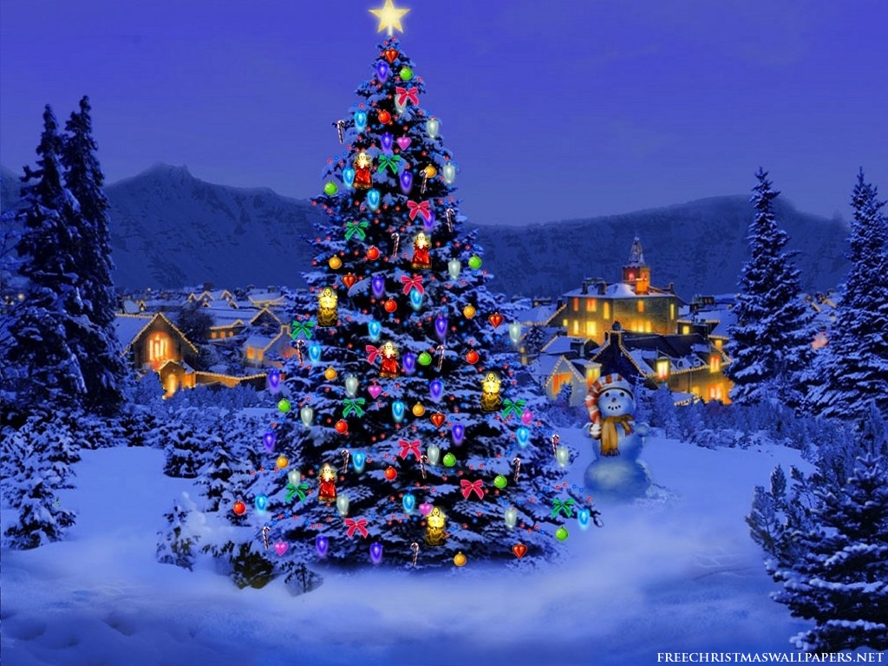
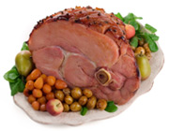
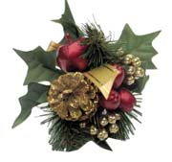
Christmas
At Christmas in Finland, everyone eat christmas foods, like cooked pork chop, turkey.
Christmas tree is also a sign of the christmas.
Christmas is time to celebrate the birth of Jesus,but it is also a time to calebrate with you familt and it has been celebrated for over thousand years.

Slide 2
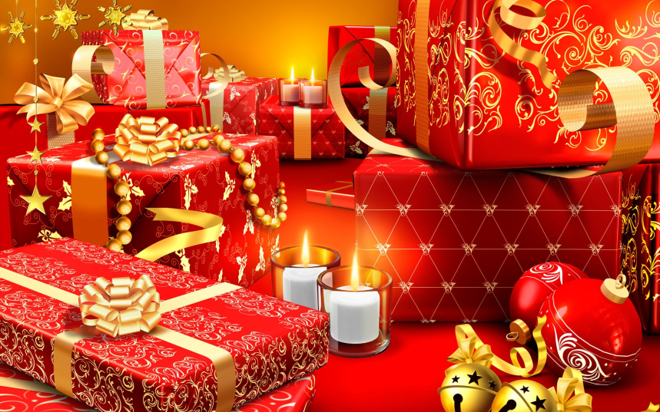
Christmas festivities
Christmas is celebrated in several days, but the most important day in Finland is Cristmas eve 24.12, when Santa Claus will come with "flying using reindeers and sleigh" giving gifts to share with people and we also opening gifts in Cristmas eve.

Slide 3
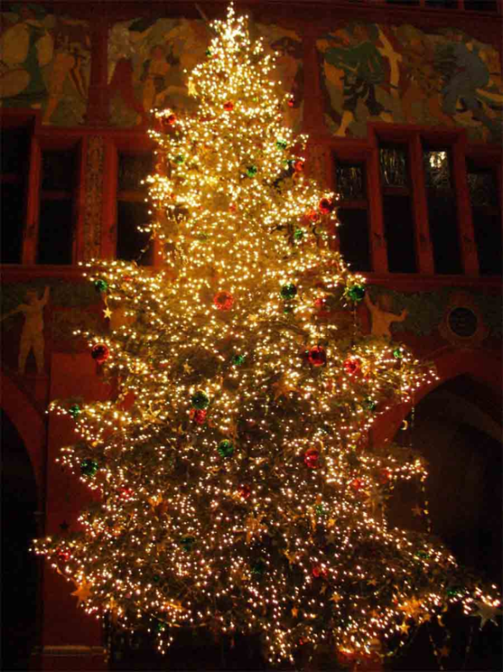
Christmas tree
Christmas tree has always been a symbol of Christmas.
We decorate it nicely in the Cristmas eve morning to look great at Christmas eve.
Later at Christmas eve, gifts are placed under the Christmas tree.

Slide 4
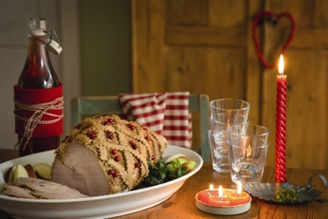
Christmas food
Christmas food has always been part of Christmas
There are a variety of Christmas dishes: turkey, pork chops, roe, potato and carrot casserole, turkey, ham and everything else.
There are also a variety of drinks and desserts such as red wine, and all kinds of desserts.

Slide 5
THANKS FOR YOUR PATIENS!!!
Made by me, Jarkko
And as always,
Have a nice day!
Problem?!

