Slide 1
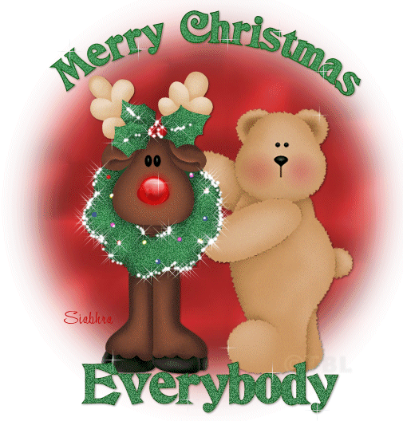
Finnish Christmas Methods
By: Kati and Miia 7D

Slide 2
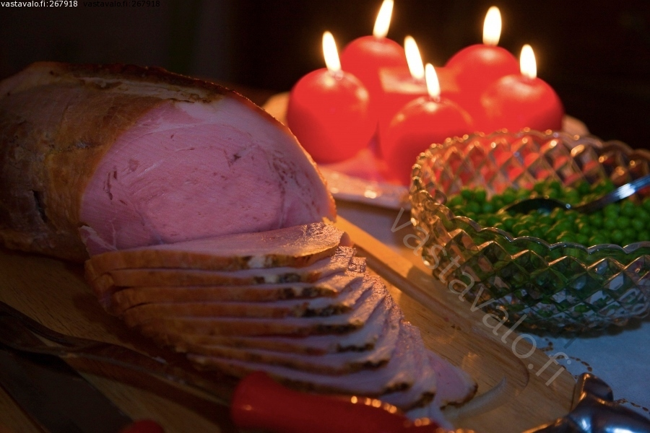
Christmas food
Christmas Finns eat a variety of food, such as ham, carrot casserole, rutabaga casserole and potato casserole. Christmas I tend to bake gingerbread cookies and tarts. Gingerbread cookies decorated with different colored sugar frosting. Some also are building a gingerbread house and decorate it.

Slide 3
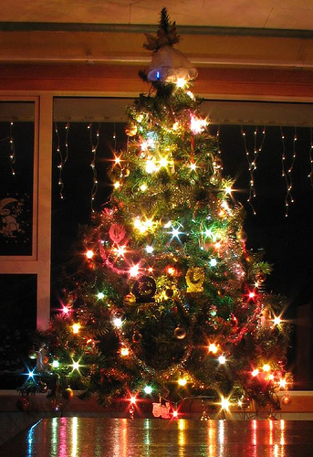
Christmas tree
At Christmas, it is customary to either buy the right Christmas tree or artificial Christmas tree. Christmas tree decorated with finely lights, Christmas balls and candles. In general, the top of the tree is placed in Christmas star.

Slide 4
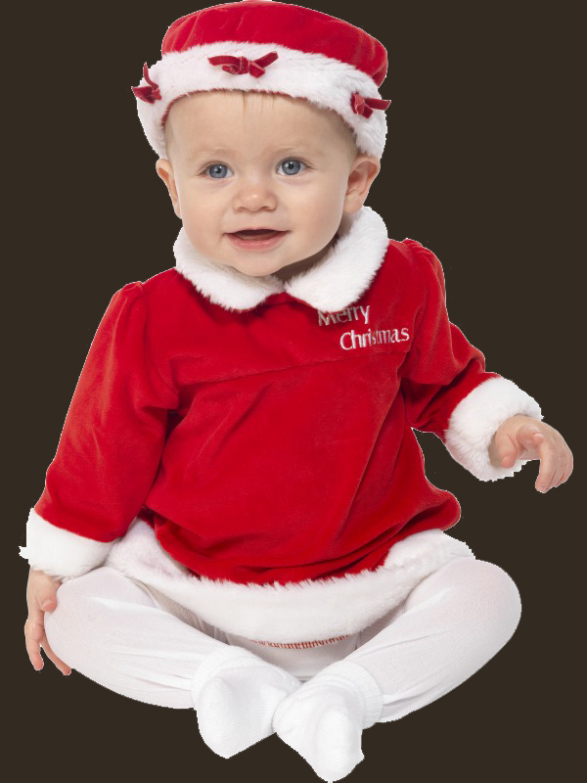
Costumes
Elf hats and festive clothes are part of Christmas. Generally, people wear red-white clothing. Some may even dress up as Santa Claus or Mrs. Claus!

Slide 5
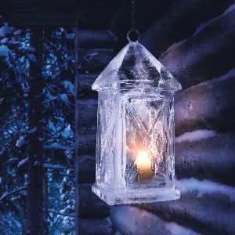
Christmas Holiday
Finnish an essential thing about Christmas is also a holiday. Christmas holiday usually lasts two weeks of school children and adults in varying degrees. Most people spend Christmas quietly at home, some go abroad or go over to their friends. Comfort level is, however, that must be free and not have to work.

Slide 6
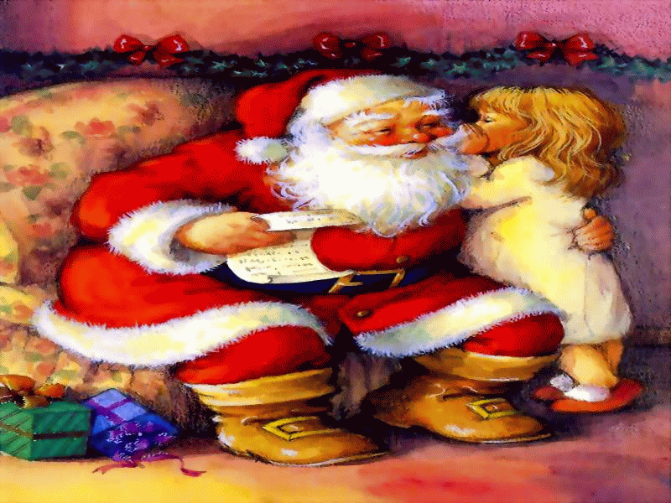
Santa Claus and gifts
There are many kinds of Christmas customs. One of them is Santa Claus bringing gifts to visiting homes. Santa Claus is usually dressed in a red, fat and bearded male. He carries a large bag gifts. It has been reported that Santa Claus would go sleigh, reindeer that pull.

Slide 7
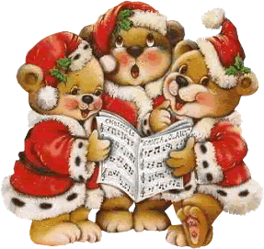
Christmas songs
At Christmas, it is customary to sing Christmas songs. Traditional Finnish Christmas songs such as Jingle Bells, Christmas tree and Santa Claus has been built for distance running. The most common song Santa Claus is coming in: Santa Claus, Father Christmas, the white beard, the old grandpa.

Slide 8
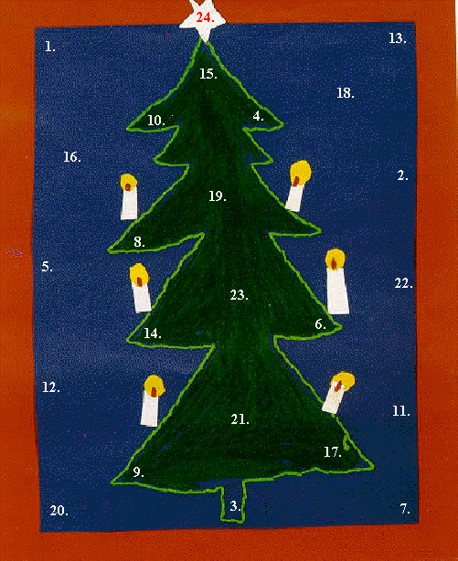
Christmas Calendar
Advent Calendar Christmas cheer is associated with an object, which is opened every day in one of the door. The calendar has twenty four door so it starts on the first day of December and ends on Christmas Eve. Calendar hatches usually found in chocolate, candy or something else even though the picture.

