Slide 1
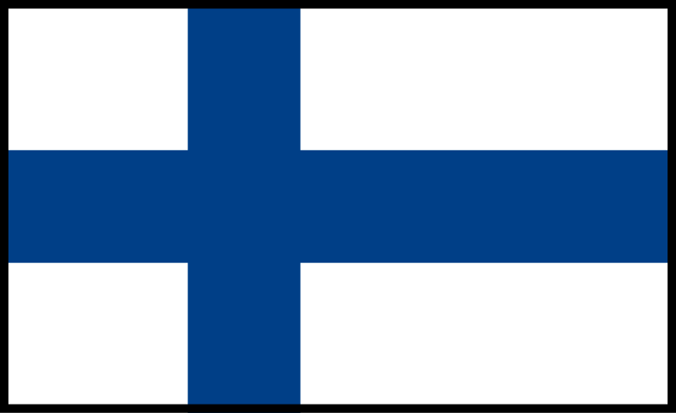
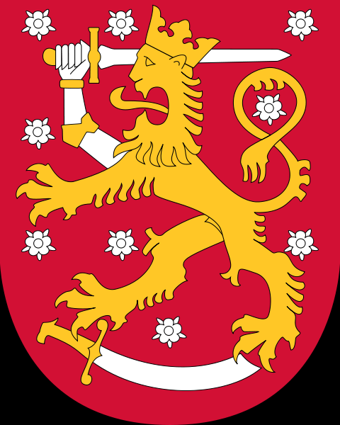
FInland
The flag and arms above.

Slide 2
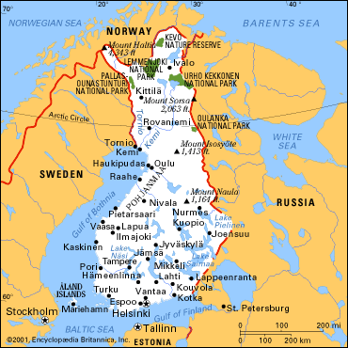
The map of Finland.
The capital of Finland is Helsinki.
We come from Vantaa. Its Half hour away from Helsinki
Other big cities are: Turku (the former capital of finland) Kuopio,Tampere and Vaasa.
There are two moutains in Finland Mount Naula (1,164 ft) and Mount Halti (4,343 ft)

Slide 3
The view of Viitasaari
This beautiful picture is captured from viitasaari.

Slide 4
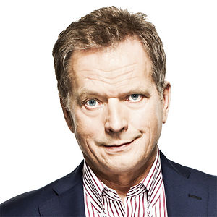
Sauli Niinistö
The current president of finland. Before Niinistö the president of finland was Tarja Halonen .

Slide 5
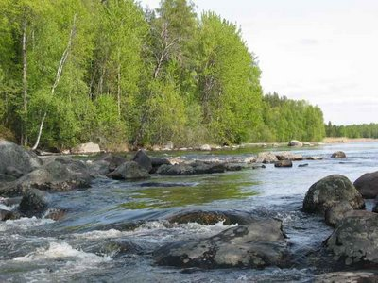
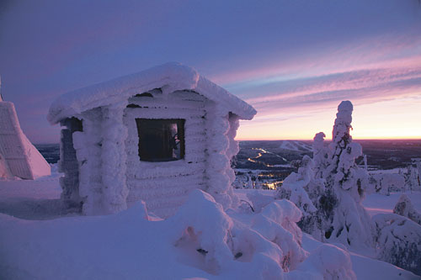
The nature of Finland
The summer of Finland
The winter of Finland

Slide 6
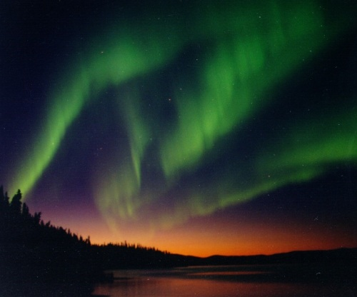
Northern lights
Northern Lights caused by the solar wind of charged particles hitting the Earth's atmosphere .
The northern lights
are appearing in
night.

Slide 7
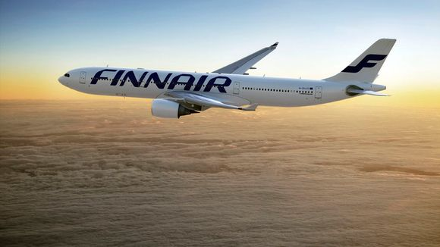
The Finnish Air company Finnair
Finnair is the aircompany from Finland since 1923
Finnair has been in its history, the three passengers in fatal accidents, and all of the company to function as Aero-

Slide 8
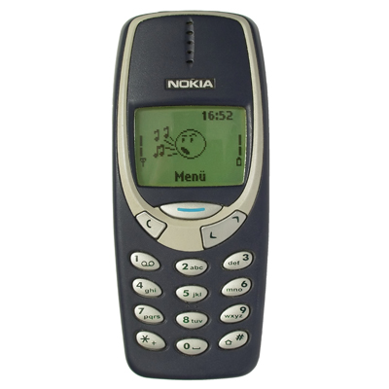
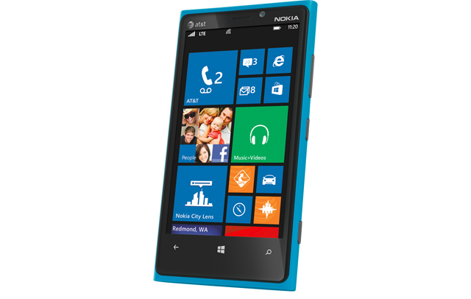
Nokia
The Older Phones.
The Phones nowadays.
Nokia 3310
Nokia Lumia 920

Slide 9
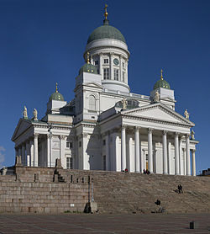
Cathedral
The cathedral of Finland is the most famous church in finland

Slide 10
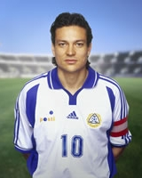
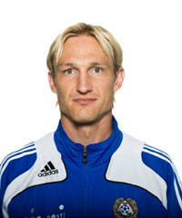
The famous football players
Jari Olavi ”litti” Litmanen
He has played in Barcelona and Ajax and many more.
Sami Tuomas Hyypiä
He has played in Liverpool and Bayer Leverkusen and some other teams. Sami was the captain of Liverpool football team.Now he is coaching Bayer Leverkusen.

Slide 11
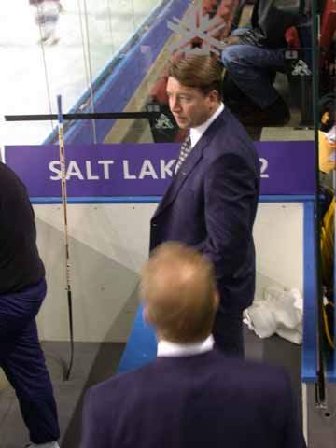
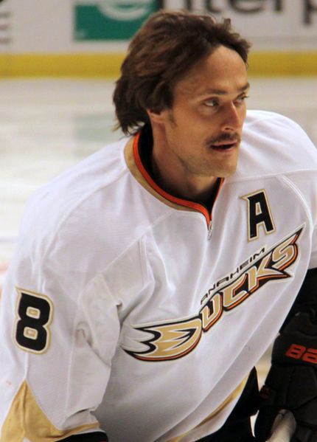
The famous ice hockey players
Teemu Ilmari Selänne
His first NHL team was Winnipeg Jets. And he made a newcomer record in Jets (76 goals)
Jari Pekka Kurri
His total scroboard rank in NHL is 19

Slide 12
This Presentation was made by
Kristian Heinolainen and Jp Käki from 7c
Thanks for watching!

