Slide 1
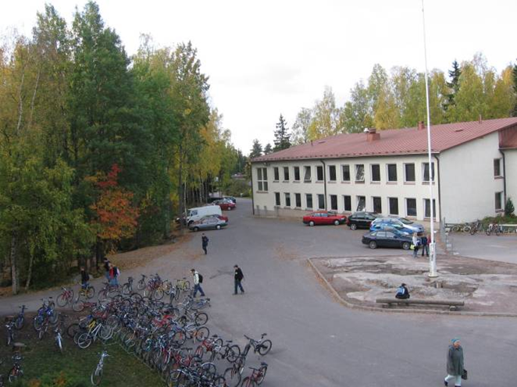
Korso school

Slide 2
Information
School has two main buildings.
The school has about 530 students.
Korso school is junior high school.
The school has a large courtyard.

Slide 3
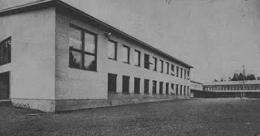
Buildings
The school has two two-storey buildings.
School has subsequently built an additional building.
Older school building is 55 years old.

Slide 4
Diningroom
The school's dining room is really big.
The food is generally good.
The opportunity to have a snack at school.

Slide 5
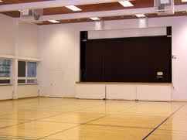
Interior
School has two computer class, music class, chemistry class and ordinary classes.
This is the party hall.
This condition is also considered a duckling rock.

Slide 6
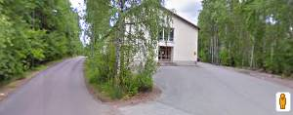
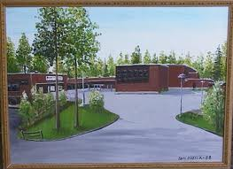
Comparison
Korson koulu
Ruusuvuoren koulu
60-minute lessons.
It’s older school.
Schools have a common sports field.
90-minute lessons.
It’s younger school.
Schools have a common sports field.

Slide 7
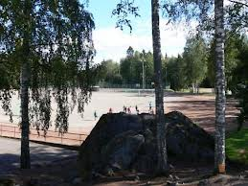
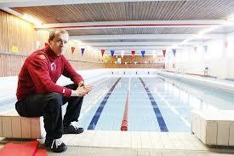
Urheilutilat
School field is a sports field.
Field is next to the tennis court.
The school has a swimming pool, which is 25 m long.
Figure former school physical education teacher Kai Liukkonnen.

Slide 8
Kiosk
School is a kiosk where you can buy snacks and treats.
Kiosks lead to student government.
The kiosk is small, but it is functional.
There's always crowded.

Slide 9
EETU LÄHDEAHO JA HANNU PENTTINEN
Thank you periodically look!

