Slide 1
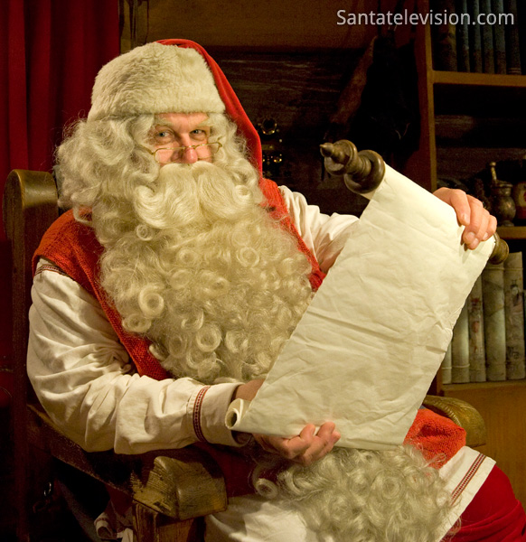
Santa Claus
Santa Claus is from Finland. Santa Claus brings gifts to children at Christmas.

Slide 2
How to recognize Santa Claus?
Santa Claus has a big white beard, white mustache, red cap, a big red jacket, red pants, boots, red gloves and glasses.

Slide 3
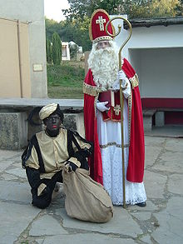
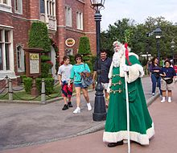
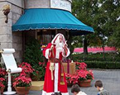
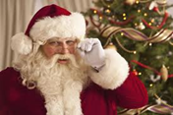
Santa Claus will also show the different countries
Dutch Santa Claus and his sidekick → → →
Great Britain's Father Christmas → →
French Santa Claus → → → →
Finnish Santa Claus →
These are just a few Santa Clauses in different countries

Slide 4
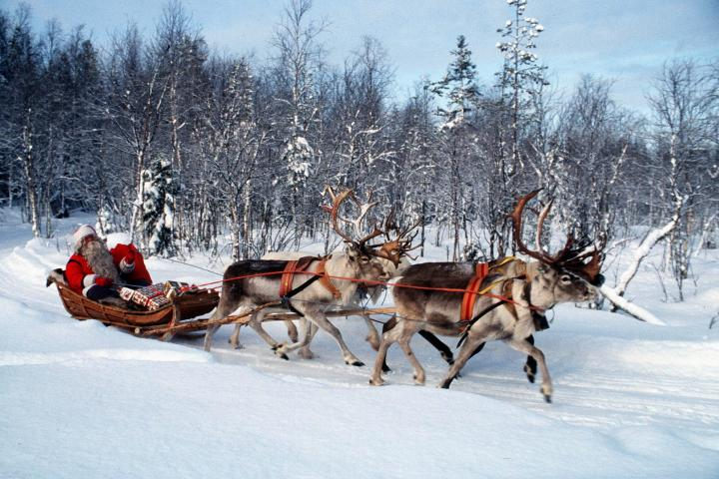
Santa's mode of transport
Santa Claus has a sleigh run by Santa's helpers, reindeer.
Santa's sleigh has to travel about 30-40 miles per hour speed. How in the world Santa Claus has time to run for about 108 million homes!? Santa's speed must be about 1 040 kilometers per second!!!

Slide 5
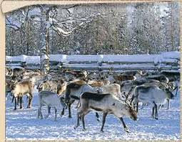
Santa's reindeer
Santa Claus has a lot of deer with it take with them the most durable and fastest reindeer. The most popular reindeer is Rudolph the red nose. Rudolph Reindeer nose shine a light. So Santa's reindeer fly.

Slide 6
History of Santa Claus
Today, the internationally acclaimed Santa Claus is based on the 300's lived in St. Nicholas. Children liked him for all children patron gifts were distributed to children Nicholas Day on 6 December. Way to spread the Dutch Protestants involved in North America.
In Europe, gifts brought the child Jesus and not Nikolaos

Slide 7
Santa's helpers others, Elves
Elves is a small human-like creature that is Santa Claus helper that makes gifts for children

