Slide 1
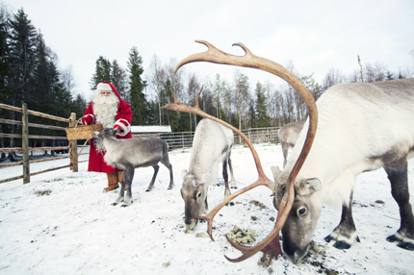
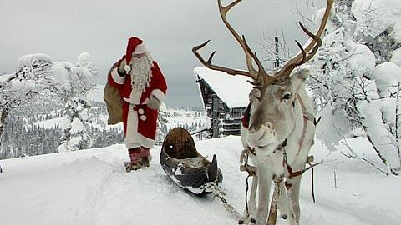
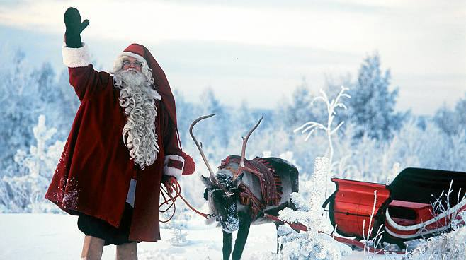
Santa and Reindeer
Santa and the reindeer have shared their gifts from around the world over the at Christmas. Without reindeer can not would be able to share their buck gifts. Then there would be Christmas. But fortunately, the reindeer Santa's best friend! Santa and the reindeer are native Finnish.

Slide 2
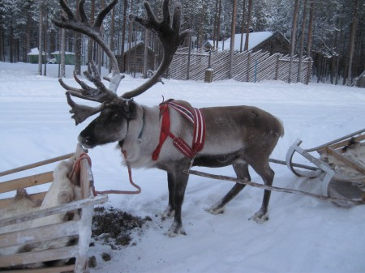
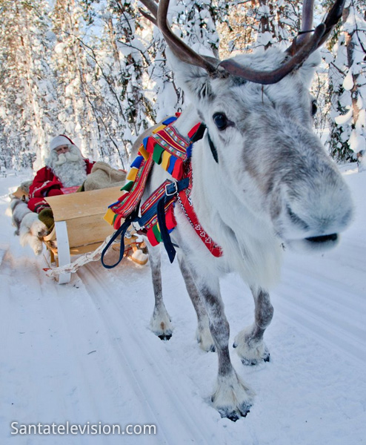
Reindeer kind of information
Santa's reindeer are helpers. Reindeer eat lichen or moss, and it allows the reindeer are able to fly and to share their gifts from around the world! Reindeer ovas also very friendly to stand as a. ☺

Slide 3
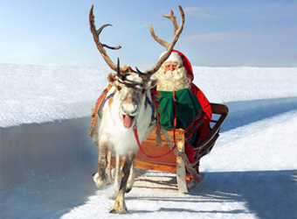
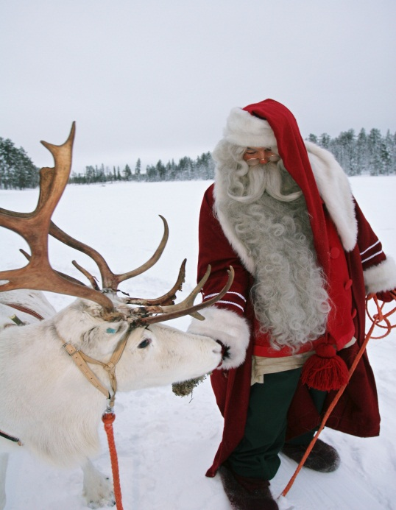
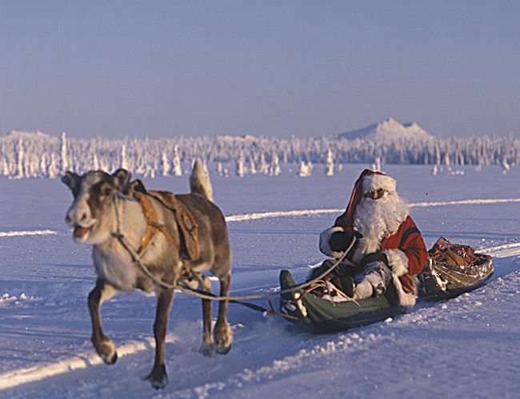
Santa Claus
Santa, share the world's children gifts so no one is excluded, but if you're naughty and you will get a package of twigs! Believe it or not. Santa Claus is a man by the do you expect that it will be behind the door gifts and to wish you a Merry Christmas. But sometimes it just pop in're not going to do other than to distribute the gifts and leave.

Slide 4
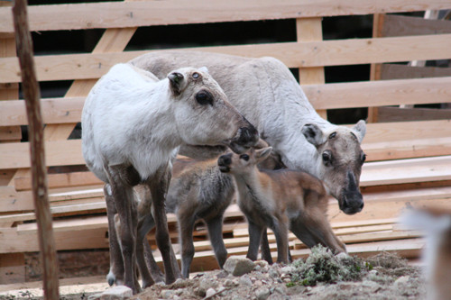
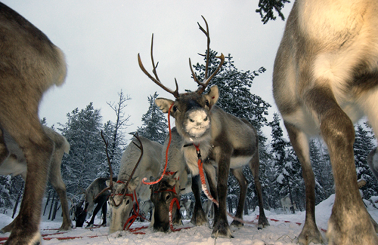
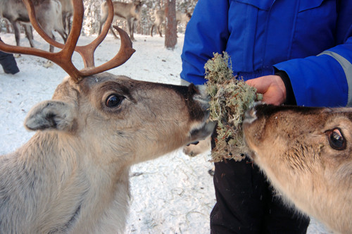
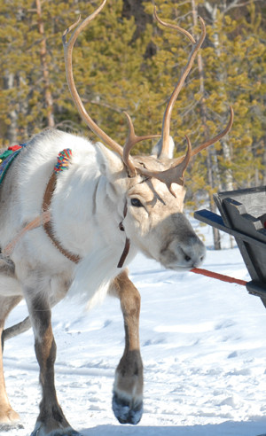
Reindeer
The reindeer is not just a helper of Santa Claus. Reindeer can also be a domestic animal.
The reindeer is the north FennoScandia living half wild animal, which graze in the mountains and forest in Lapland. The reindeer is the ancestor of the deer especially mountain reindeer
Reindeer in Finland in 2001 was 185 000 the maximum amount of reindeer in 2000-2009 was 203 700 individuals
Reindeer eat lichen and hay, and no matter what as long as it is suitable for food.

Slide 5
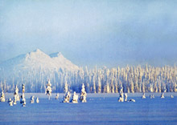
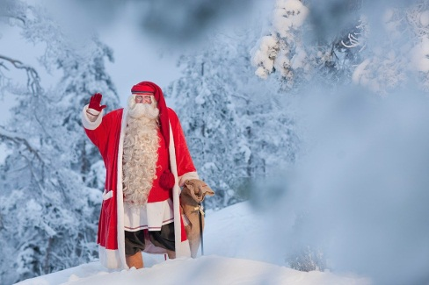
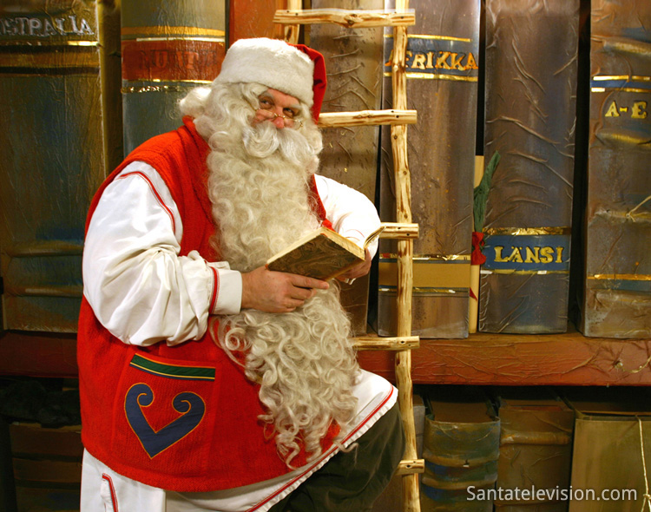
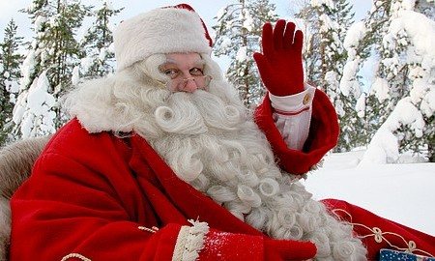
History of Santa Claus
Santa Claus is a benevolent fictional male character who brings gifts at Christmas.
Today, Santa Claus has been described species, solution old man in a large white beard and glasses.
Children tend to write a list of harvesting desired gifts. The letter is often given to parents arrive for delivery. Santa Claus who brings gifts
Santa Claus lives in Korvatunturi mountain which is located in the eastern border of Finland.

