Slide 1
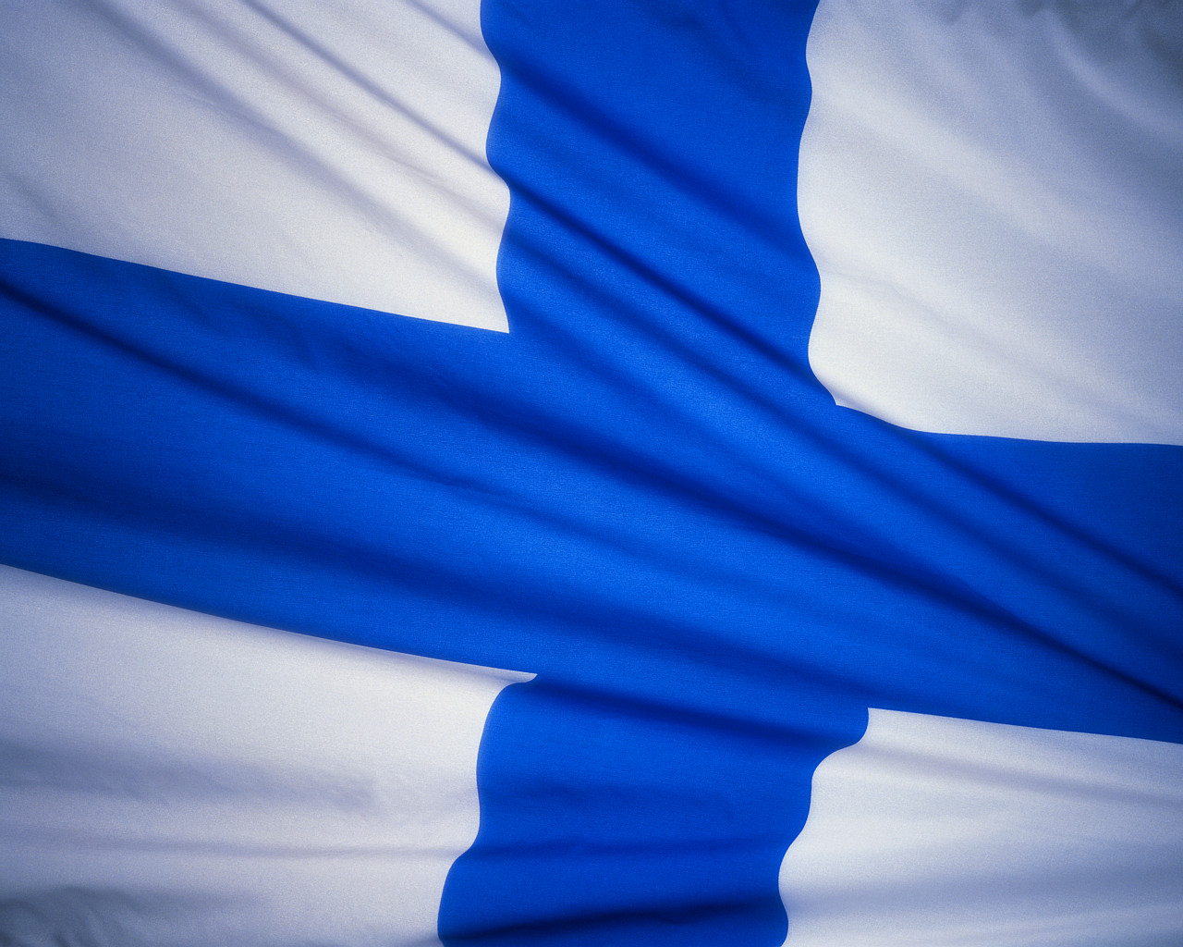
Finland

Slide 2
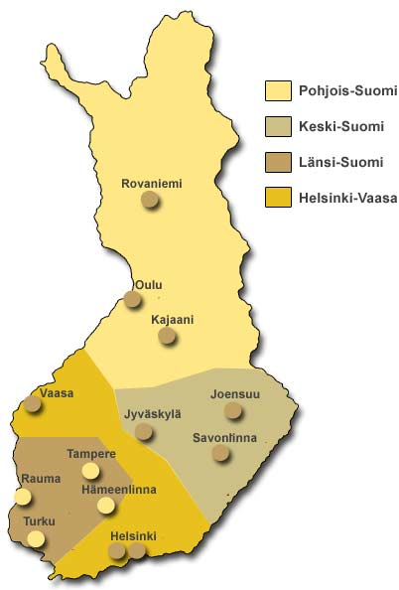
Map of Finland
Our capital city is here
And we live here

Slide 3
Statistics
Population is 5 420 981 people
Capital is Helsinki
Area is 338 432,07 km²
Currency is euro
Time zone is utc+2
President is Sauli niinistö

Slide 4
Language
In Finland we speak finnish and swedish.
Suomi = Finland
Suo = swamp
Järvi = lake
Maito = milk
Hei = hello
Hei hei = bye bye

Slide 5
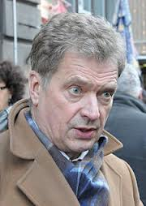
President
We have a president. He`s name is Sauli Niinistö
He is 64 years old and become
our president in 2012.

Slide 6
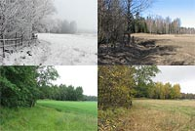
Nature
In Finland we have four distinct seasons, winter, spring, summer and autumn.
winter
spring
summer
autumn

Slide 7
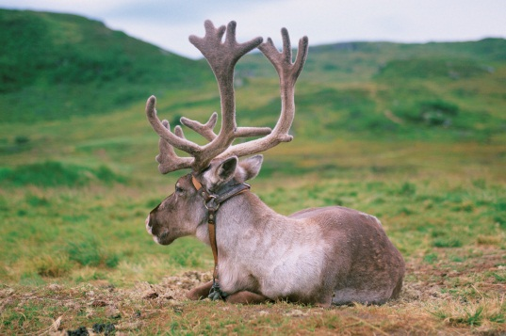
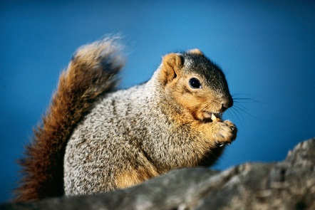
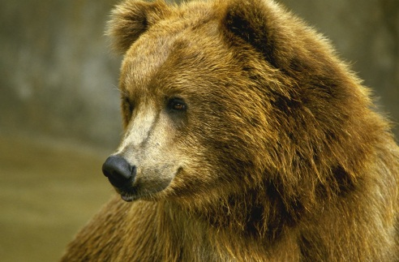
Animals
Finlands national animal is bear, but we have lot more animals.
Squirrel
Bear
Reindeer

Slide 8
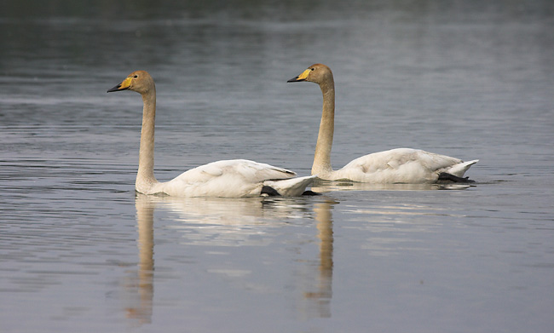
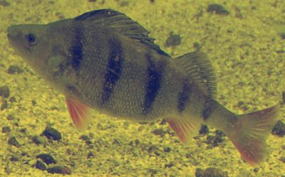
Other animals
Our national bird is whooper swan and national fish is perch
Whooper swan
Perch

Slide 9
Vegetation
We have spruces and desiduous trees. Finland is at northern and- southern boreal
Vegetation zone.
Koli national park

