Slide 1
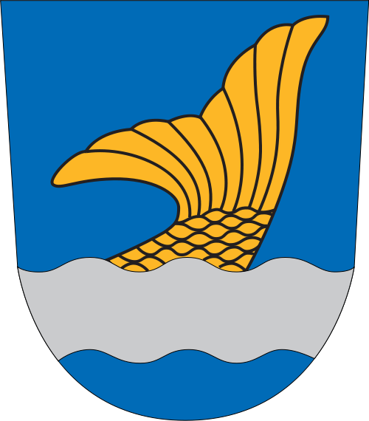
VANTAA

Slide 2
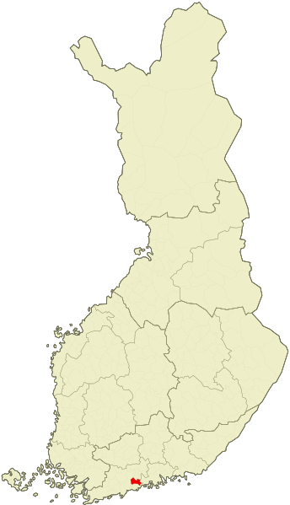
Information in Vantaa
Finland's fourth largest city
Is part of the metropolitan area
Founded: 1351
City: 1974
Area: 240.34 km ²
Mayor: Kari Nenonen

Slide 3
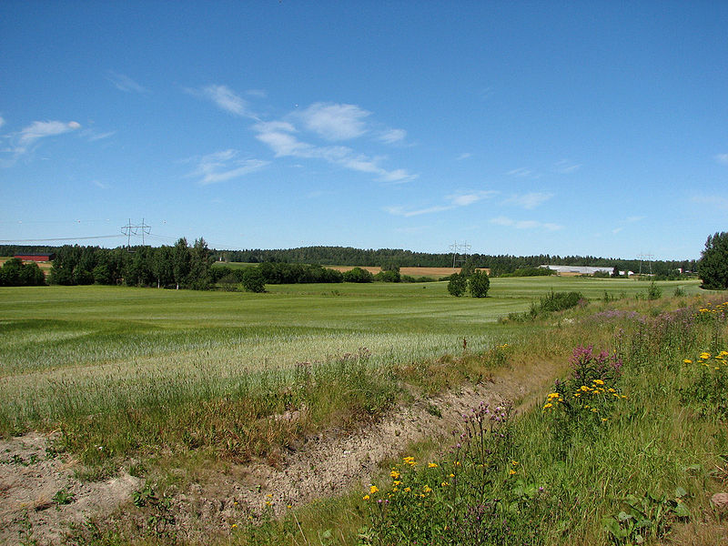
Vantaa Geography
Mainly in rivershalkomaa low-lying areas.
The center of Vantaa can find such a quiet area. Western Vantaa is very hajarakennettua area. The image is Viinikka child.
Coulter bedrock is old.

Slide 4
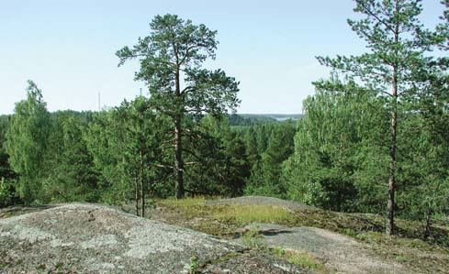
Vegetation
Vantaa is north of the coniferous forest, or boreal zone and represents the vegetation zone of the southern parts, and is opposed to karummalle Lapland, which represents the northern part of the boreal
Vantaa is located in the northern boreal alavyöhykkeistä higher in southern Finland inland characterizes the southern boreal and south-western Finnish characterizes hemiboreaalisen alavyöhykkeen border area. Hemiboreal is a transitional coniferous and deciduous forests in between, and there is growing among naturally tree in a forest of conifers such as oak and elm.

Slide 5
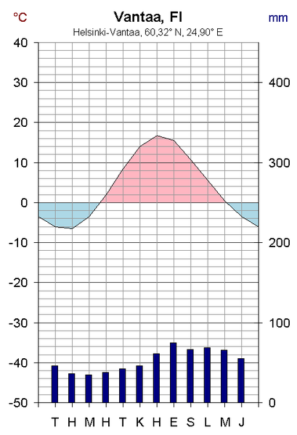
Climate
Vantaa, the climate is cool temperate cold winter and hot summer.
The city is located Köppen climate classification DFB-type climate area close to the DFC and the colder climate type of the border.
Climates characterized by less than 3 ° C, the average temperature in the summer and the coldest month of 10-22 ° C, the average temperature of at least four months. February is the coldest month, when the average temperature is an average of about -6 degrees.

Slide 6
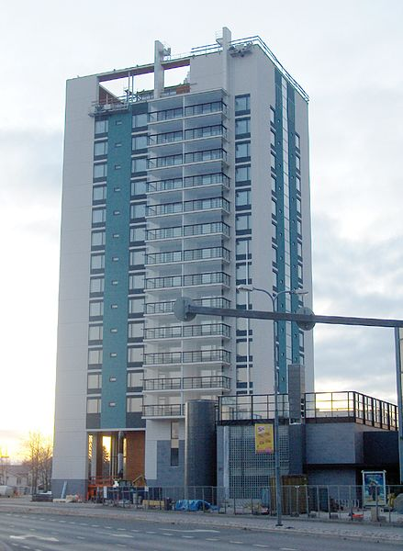
Population
Lived in Vantaa, Finland 31.08.2012 31 elokuuta 2012 204 545 people. Vantaa type of about half of the native range of the Helsinki Metropolitan Area.
Vantaa population of Helsinki and Espoo working-class, which is reflected, among other things, in the fact that people's jobs are in manufacturing and logistics.
Vantaa employees earned an average of 22 452 € in 2002, which is higher than the national average (19 470 €), but less than in other metropolitan municipalities.

Slide 7
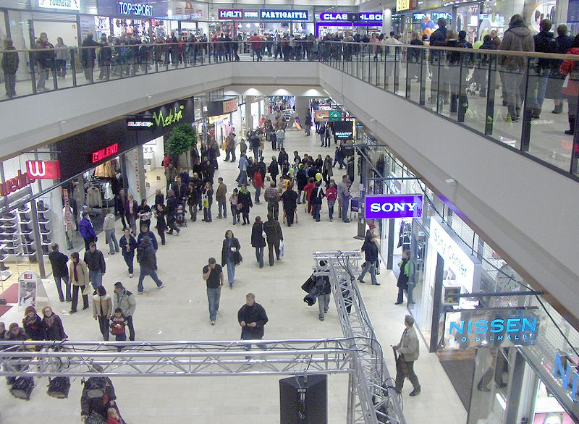
Services
Vantaa is divided into seven major areas: Myyrmäki (50 607 inhabitants), Kivistö (7 628 inhabitants), Aviapolis (15 042 inhabitants), Oak Brook (24 587 inhabitants), Korso (28 575 inhabitants), Tikkurila (36 892 inhabitants) and Hakunila (28 748 inhabitants). [23]
Vantaa has a total of 50 Finnish-speaking and Swedish-speaking five primary schools. High schools in five of the Finnish-language day of high school and one in Swedish. In addition, Vantaa is a distant upper and two adult high school. There are two professional educational institutions: Vantaa Vocational College Varia and merchants business college. Helsinki Metropolia University of Applied Sciences offers teaching and Laurea.

Slide 8
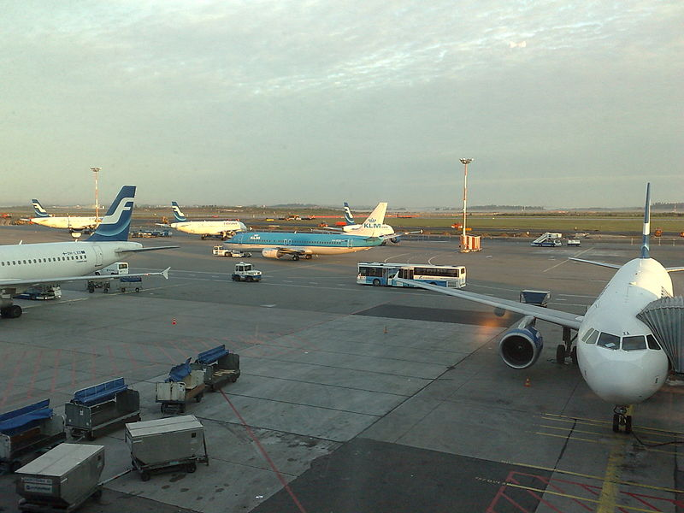
Traffic
Helsinki-Vantaa Airport is Finland's biggest airport. The number of passengers to 11.1 million in 2005
Helsinki-Vantaa Airport has selected its size class in the world or the best airport in Europe in 1999, 2000 and 2004

Slide 9
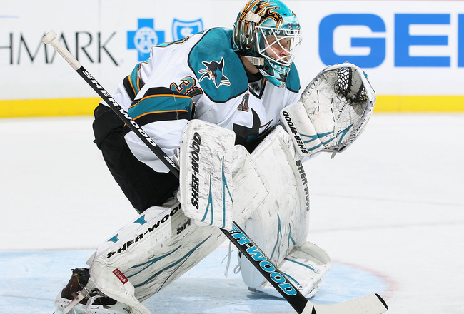
Antti Niemi
Born on 29 August 1983 (age 29) Vantaa citizenship Finland Position goalkeeper bat right Mitt left Length of 188 cm Weight 91 kg Nickname Andy, Nemo [1]
Society of San Jose Sharks / Pelicans Series NHL / Hockey League Game # 31 Pelaajaura Pääsarjaura 2005 - Adult clubs Dial-Vantaa (Mestizo) Pelicans (SM-liiga) Rockford IceHogs (AHL) Chicago Blackhawks (NHL)

