Slide 1
Vantaa

Slide 2
The establishment of the City of Vantaa.
In 1972, the Rural Municipality of Helsinki Vantaa changed to this township and in 1974 to the current city of Vantaa.

Slide 3
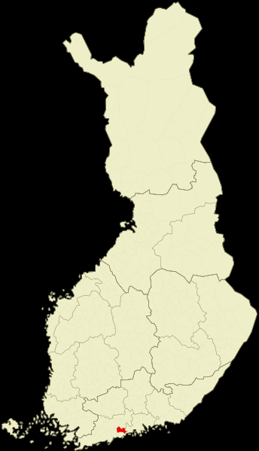
Location of Vantaa
(Vantaa has been marked with the red colour.)

Slide 4
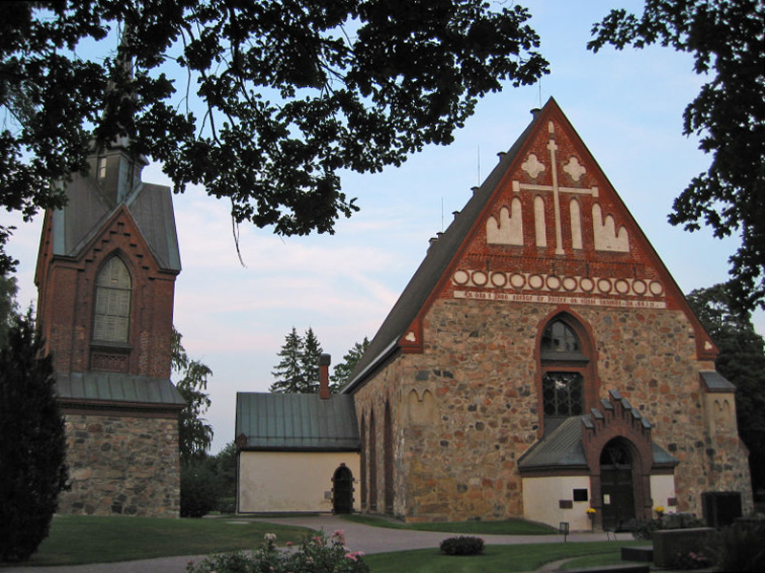
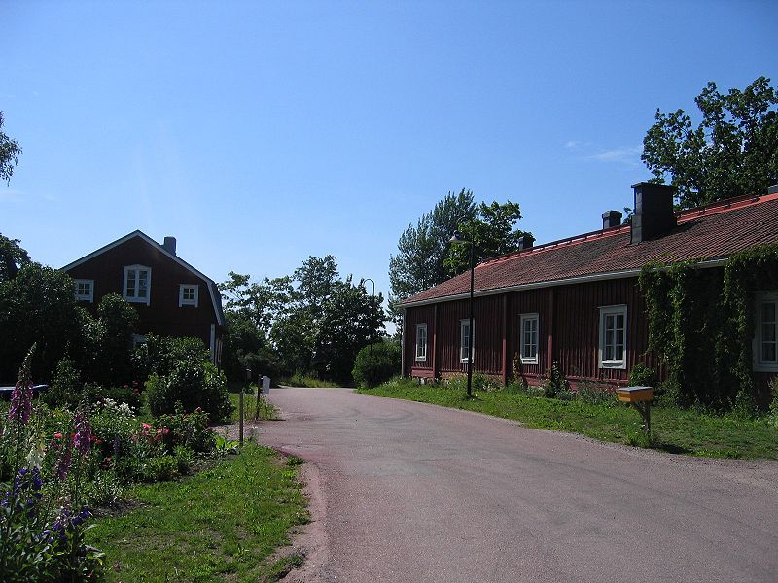
Helsinki’s parish church village
St. Lawrence Church is located in the oldest village of Vantaa.
The road to Helsinki parish church village.

Slide 5
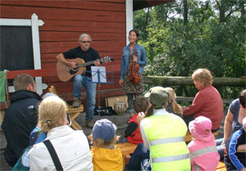
People in Vantaa
In 31.08.2012 there was living 204 545 people in Vantaa.

Slide 6
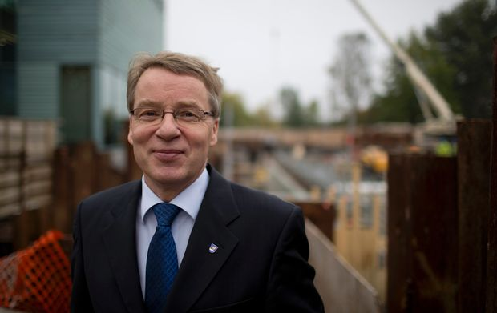
The mayor of Vantaa.
The mayor of Vantaa’s name is Kari Nenonen. He was a finnish writer.

Slide 7
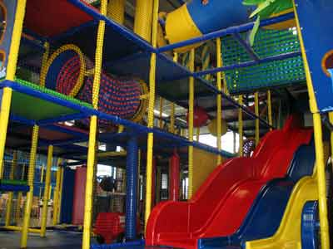
Vantaa’s child-friendliness
Vantaa is pretty child-friendly. There is many places that a child can go play and celebrate his birthday like perhaps Hoplop. You can see Hoplop in the picture.

Slide 8
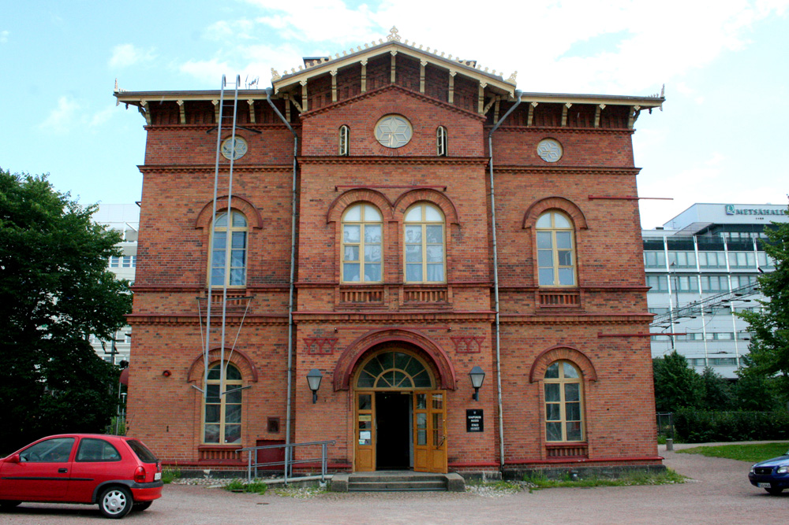
The sights of Vantaa
This is the museom of Vantaa. It’s in Tikkurila.It contains lot of Vantaa’s history.

Slide 9
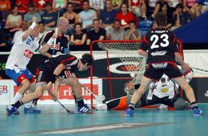
Vantaa’s kids favorite hobby.
Floorball
Vantaa’s kids favorite hobby is floorball. Maybe it’s because Finland is the worldchampion in floorball.

