Slide 1
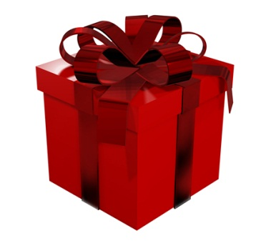
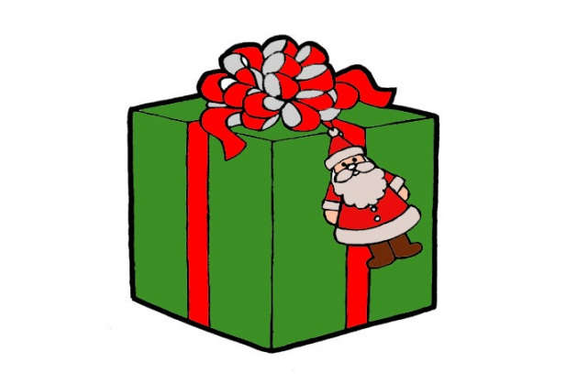
Santa Claus
Santa Claus is a imaginary character, whom children are waiting, to bring Christmas gifts.
People dressed as Santa Claus and share their gifts mostly for children.
Santa Claus is a bushy white beard and a red coat and hat.

Slide 2
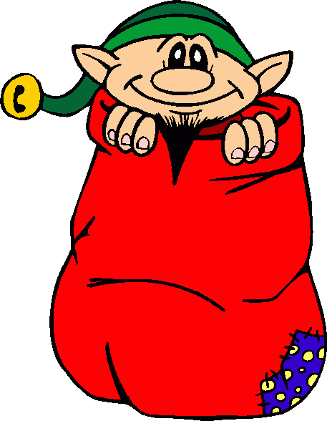
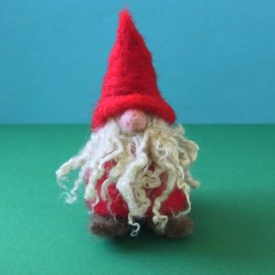
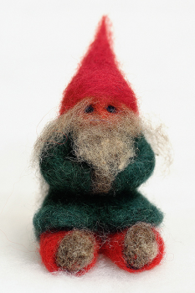
Christmas elf
Santa Claus has a lot of little helpers, such as Christmas elves.
elves are considered by many opinion figure, whereby with a long beard and red clothes, such as Santa Claus
some people say that before Christmas, the elves are watching kids and tell Santa Clause and whether they were good or bad.

Slide 3
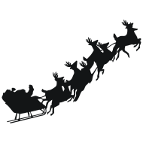
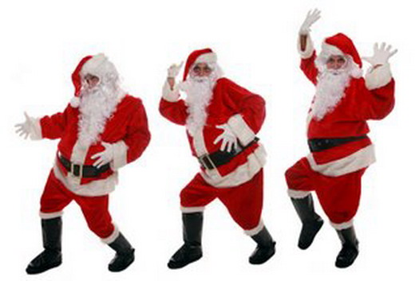
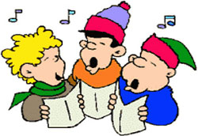
’’Santa Claus trip already visited’’
Santa Claus and Christmas is made there are many children's songs
Also the books have been written about Christmas many.
it is said that Santa Claus arrives to bring gifts to a flying sleigh, which is controlled by flying reindeer. Reindeer from main is anyway reindeer whose name is Peter. Rudolf is important because it is the red nose which illustrates the way in the dark.

Slide 4
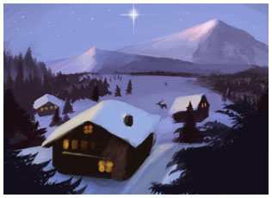
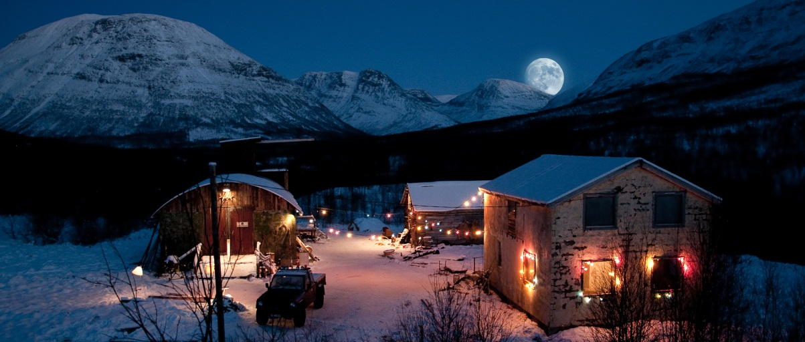
KORVATUNTURI
Santa's home is Korvatunturi, which is home to Santa Claus addition, elf, reindeer and Santa's good friends.
Korvatunturi is always a lot of fun and every day is there than to celebrate.
Korvatunturi is only one working day and it is the day when Santa leaves the reindeer with gifts to share.

Slide 5
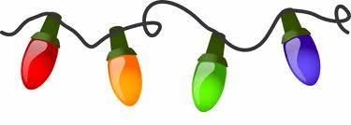
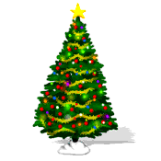
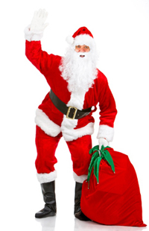
Christmas festivities
For many families celebrate Christmas and Santa Claus will bring gifts.
some families just given gifts or it is said that Santa Claus brought gifts under the Christmas tree.
Christmas, it is customary to decorate the Christmas tree before Christmas Eve.

Slide 6
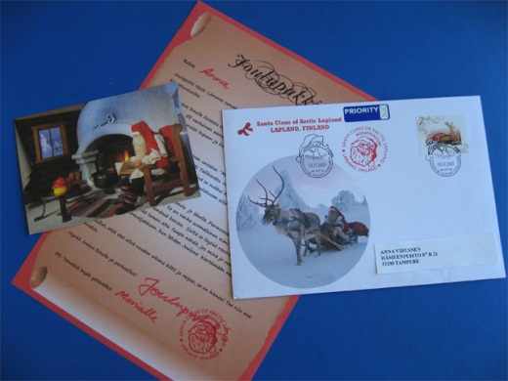
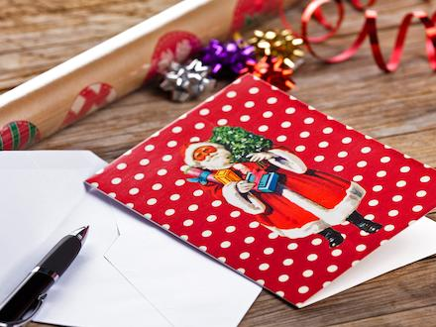
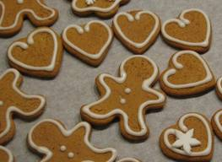
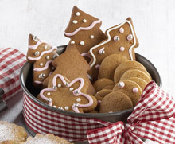
Letters to Santa Claus
In Finland, children leave Santa Claus letters in which they to tell you what they want a Christmas present.
Sometimes children hide the letter, for example under the carpet, the elves are looking and take Santa Clause
some put the elves and gingerbread cookies on a plate with a glass of milk that they manage to keep a child's.

Slide 7
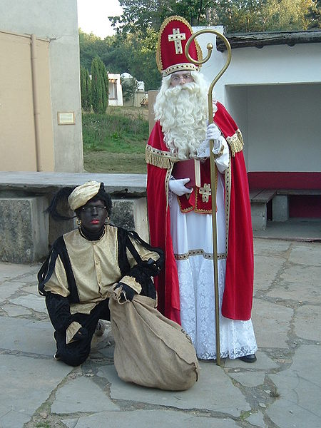
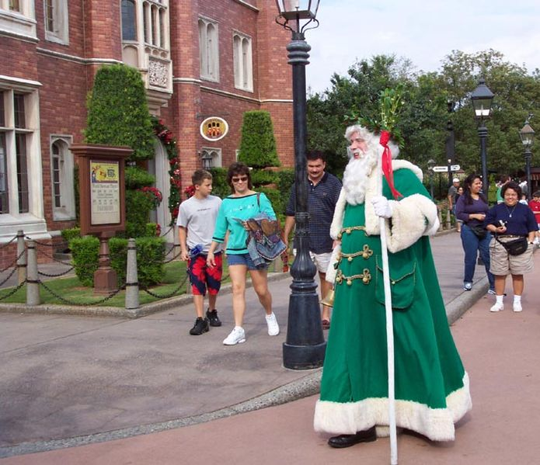
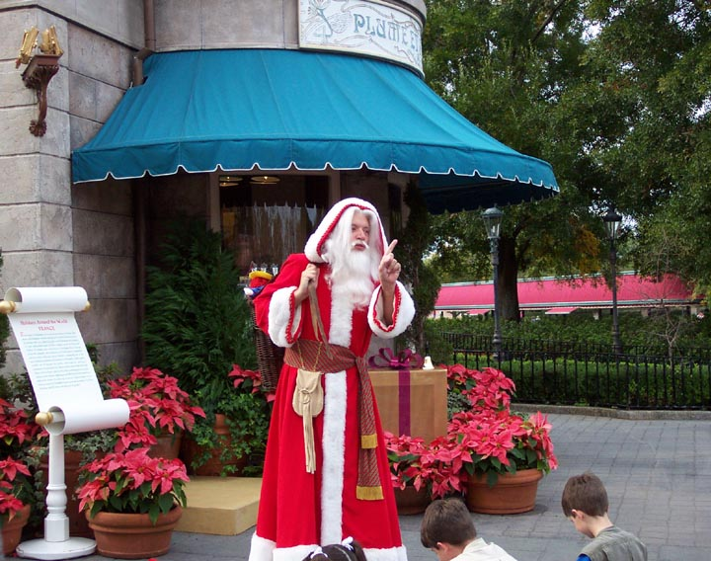
Santa Claus travels
Santa Claus is in many different countries and many different types.
Holland Santa Claus is long high hat, with an image of the cross.
Santa Claus in the UK is a green coat and hat made ​​from plants.
France is almost similar to Santa Claus, as we have here in Finland, but there are some minor differences you can find.

Slide 8
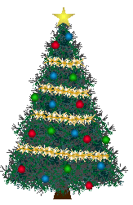
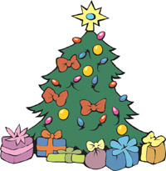
Christmas tree
Christmas tree is just a normal tree, which is decorated with cheerful colors and spruce roots to ends to put the star.
Some people say that Christmas ends when the Christmas tree stripped of ornaments and thrown away.

Slide 9
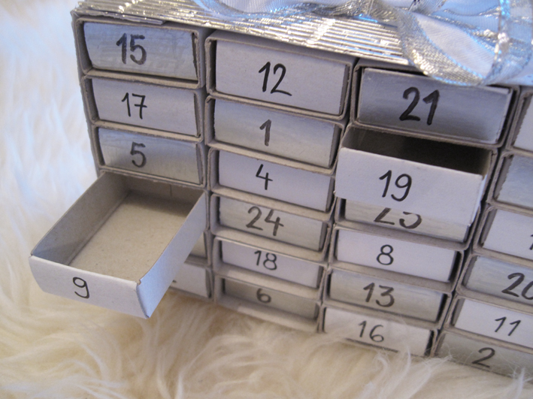
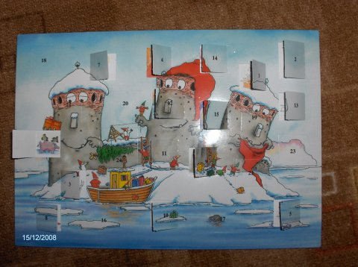
Christmas calendar
Children bought a calendar with 24, and every day the door to be opened one-stop shop. Then, when everything is opened so it is a time when Santa Claus will bring gifts
Christmas Calendar is the most common kind of where to get a small piece of chocolate.
as the name suggests is Advent Calendar give Christmas (December)

