Slide 1
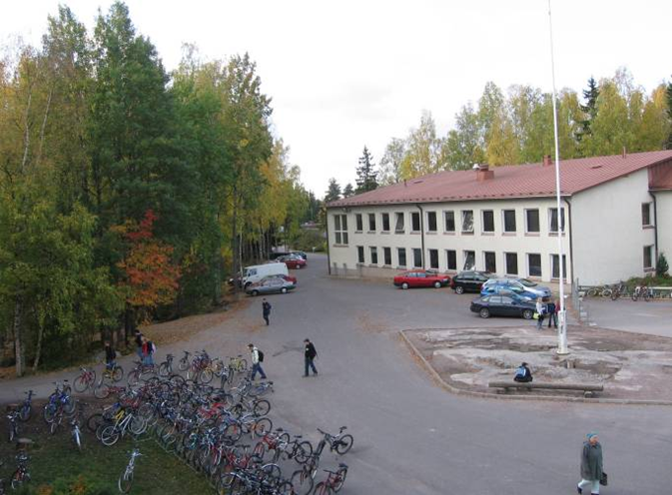
Korso’s School

Slide 2
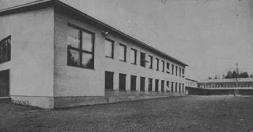
About school
The school has about 530 students.
The school has two two-storey buildings
The older building is 55 years old and was built in 1957
This is older Building in 1960

Slide 3
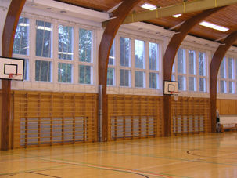
The school's facilities
The school has a small indoor swimming pool
The school has 2 sports halls and there is also a sport field and climing wall
The school's Sports hall

Slide 4
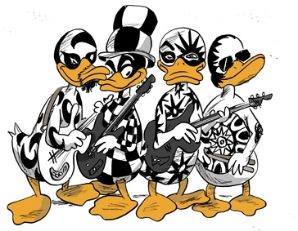
Duckling Rock
Korso school organizes Duckling rock every year
There school bands paly and sings. First to the own students and in the evening to the parents
Students desing every year a Duckling rock’s logo!

Slide 5
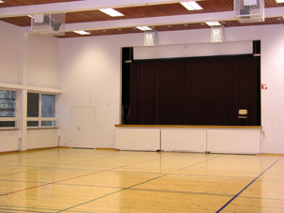
Interior
Korso school has two chemical classes
Korso school has three computer classes
One partyroom
The school has a small kiosk, take care of the student government
Partyroom

Slide 6
This Presentation of korso school was made by
Oskari Tauriainen

