Slide 1
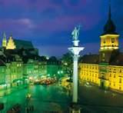
Warsaw
Famous places in Warsaw

Slide 2
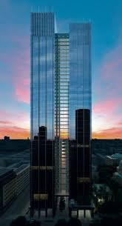
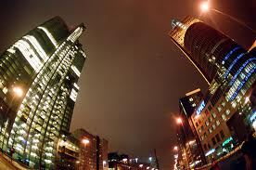
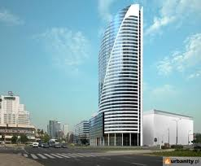
Warsaw skyscrapers
Warsaw skyscrapers - a collection of about 40 buildings (skyscrapers) in Warsaw with more than 65 m in height (in two cases more than 200 m), and about 55 new ones (from 70 m to 350 m) in various stages of implementation. These are the skyscrapers currently being built and rebuilt, with permission to build, and planned to await approval for their implementation.

Slide 3
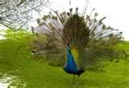
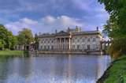
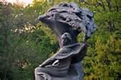
Royal baths
chopin monument
Palace on the water
Garden
Royal Baths Park in Warsaw - a palace and park in Warsaw, with many monuments classicist, founded in the eighteenth century by King Stanislaw August Poniatowski. The whole premise was realized by architects royal Dominik Merlini, Johann Christian and Johann Christian Kamsetzer Szucha. Park fulfills its task today as when it was created. It is the site of numerous events of cultural, scientific, entertainment and sports, as well as a favorite place for walks Warsaw.

Slide 4
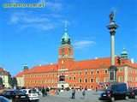
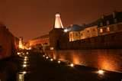
Old town
The Royal Palace
Old town
Old Town in Warsaw - Warsaw's oldest urban center which is a compact team of historic architecture, mostly from the seventeenth and eighteenth century, the medieval building layout, surrounded by fortified walls of the XIV century.

Slide 5
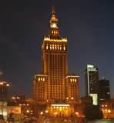
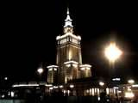
The Palace of Culture and Science
The tallest building in Poland, in the city center on the Parade Square. Intellectual capital city of Warsaw. The object manages the municipal company "Management of the Palace of Culture and Science" Sp. of o.o. It was built as a gift from the Soviet people for the Polish people.

Slide 6
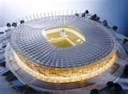
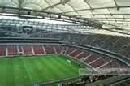
The National stadium
Multi-purpose stadium on Kamionku in Warsaw, built for the tournament of the UEFA European Football Championship Euro 2012. Stadium was built in the basin of the former Tenth Anniversary Stadium. It has the fourth category in the classification of UEFA (the highest), is 58.5 thousand on it. seats for spectators

Slide 7
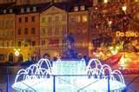
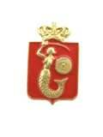
Warsaw mermaid
I do not know where the siren took the coat of arms of Warsaw, in any case, it was already in 1390. But then, this siren was a completely different shape than it is today. Coat of arms of Old Warsaw in 1390 presented the animal with bird legs and torso covered with dragon's scales. On the seal of 1459 she had feminine characteristics, trunk bird, human hands, tail fish and bird legs ending in claws. However, the first presentation of the siren (half female-half fish) dates back to 1622.

Slide 8
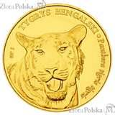
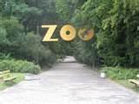
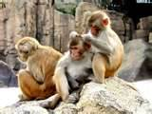
Zoological Garden
Zoo is to serve primarily an educational and recreational, but modern facility of this type tend to have a science base needed for systematic studies on cultured species.Garden zoo, zoo - decorated and landscaped grounds with technical infrastructure and buildings associated with it functionally, where are kept and exhibited to the public for at least 7 days in live animals of the wild, with the exception of:

Slide 9
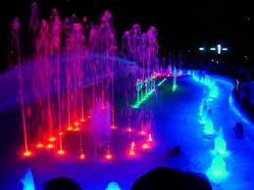
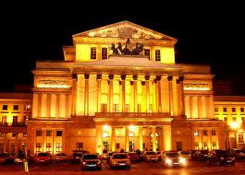
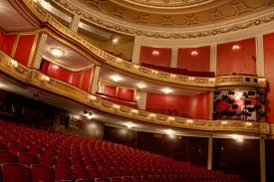
Grand theater
Grand Theatre - National Opera in Warsaw - building located on Theatre Square in Warsaw, home of the National Opera. The Halls Reduta Theatre Museum is located, and two of the three stages of the National Theatre.

Slide 10
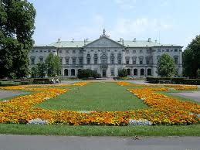
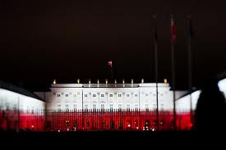
Presidential Palace in Warsaw
Presidential Palace in Warsaw (also Koniecpolski, Radziwill, Lubomirski, Governor), the palace in Warsaw, in the city center, at the Krakow suburb, since 1993, [1] the seat of the President of the Polish Republic. The Presidential Palace is the most magnificent edifice at the Krakow suburb, and while most of Warsaw's palaces. Pokarmelickim stands between the church and the hotel Bristol. Originally looked different, and its present appearance and traditional name (Governor's Palace) gained in the nineteenth century when major renovation.

Slide 11
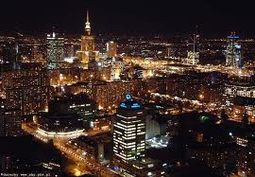
The end
Made by : Daria Kamińska

