Slide 1
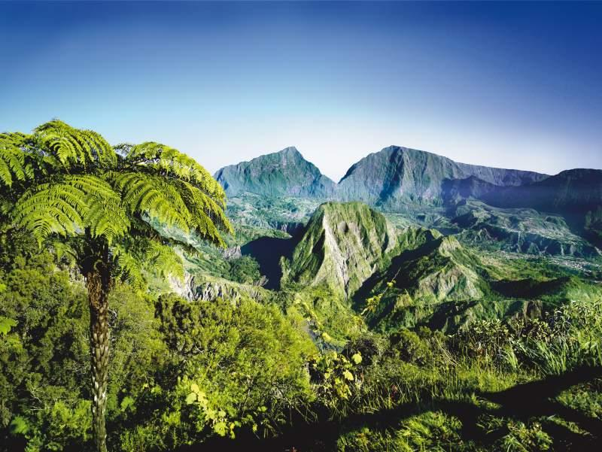
WELCOME TO REUNION ISLAND…

Slide 2
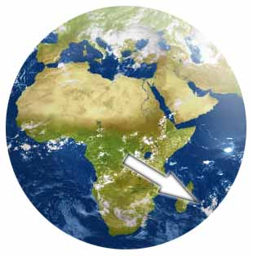
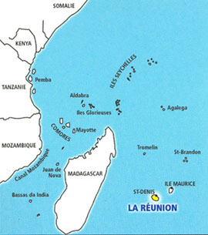
REUNION ISLAND IS A FRENCH OVERSEA DEPARTMENT, LOCATED IN THE INDIAN OCEAN

Slide 3
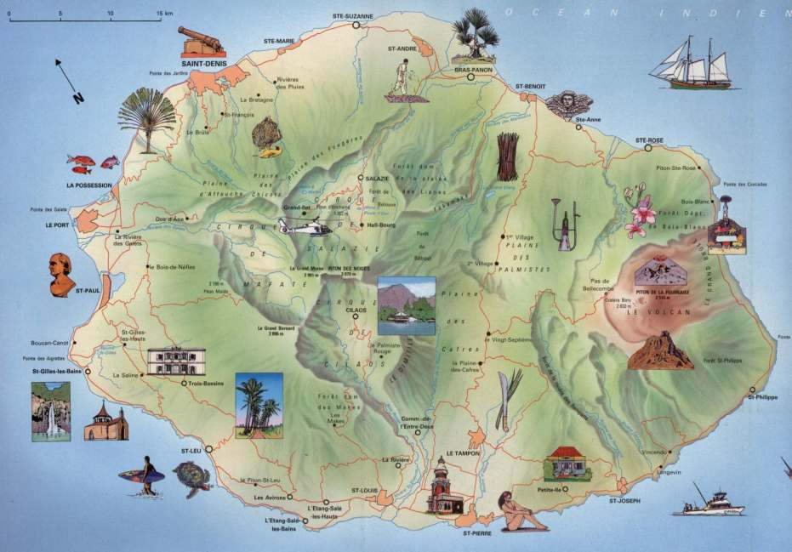
IT’S A TINY 30–MILE-WIDE ISLAND

Slide 4
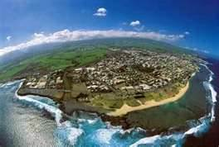
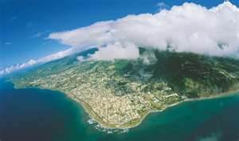
REUNION ISLAND IS A SMALL DOT IN THE INDIAN OCEAN …
… YET IT IS SO INTENSE AND SO FULL OF LIFE

Slide 5
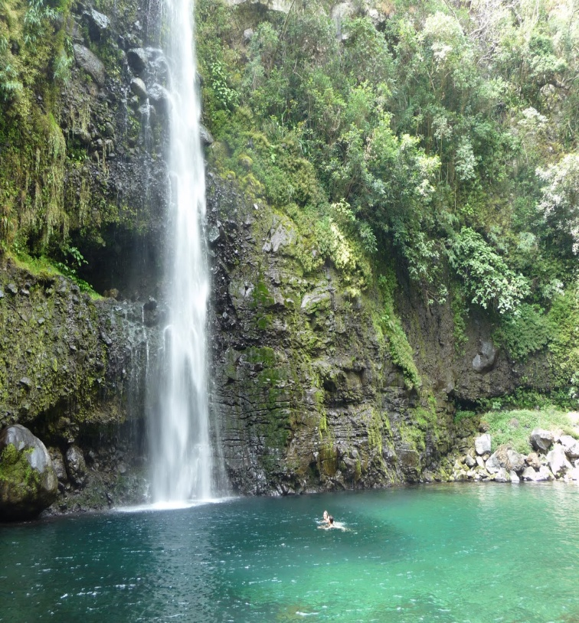
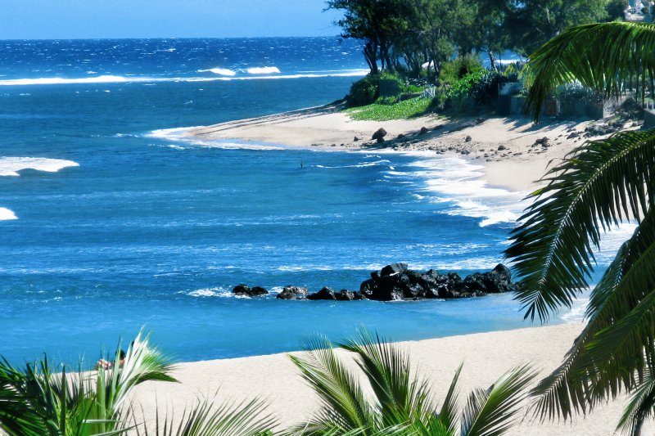
REUNION ISLAND IS A LAND OF CONTRASTS
WATERFALLS, BEACHES …

Slide 6
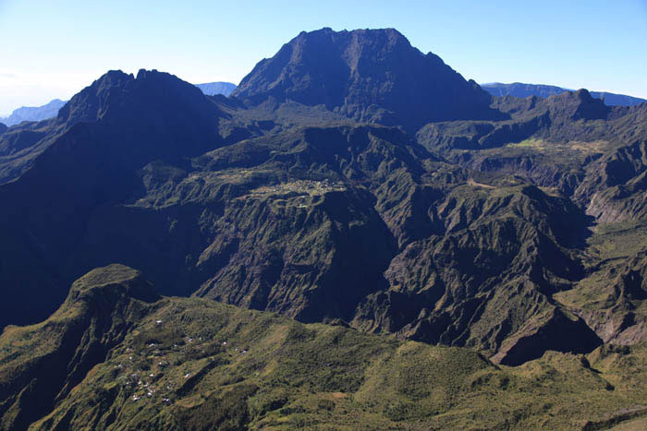
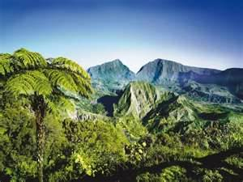
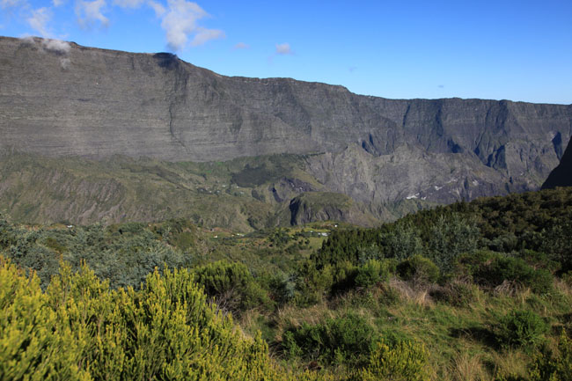
… HILLS AND MOUNTAINS ARE ALSO PART OF THE LANDSCAPE

Slide 7
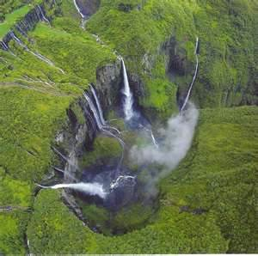
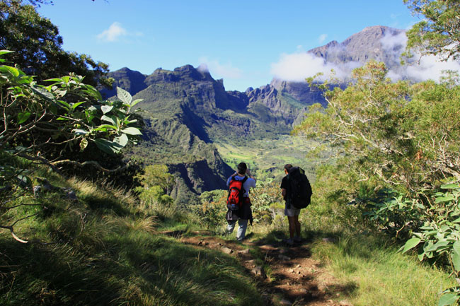
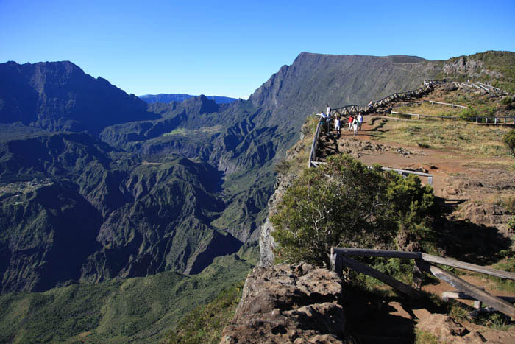
HIKING IS ONE OF THE BEST WAYS TO DISCOVER THE ISLAND

Slide 8
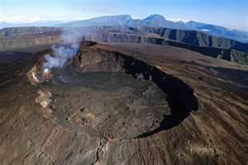
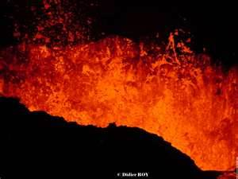
REUNION ISLAND WAS BORN FROM A VOLCANO
WE HAVE A VERYACTIVE VOLCANO :
« LE PITON DE LA FOURNAISE »

Slide 9
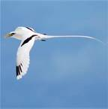
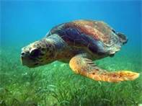
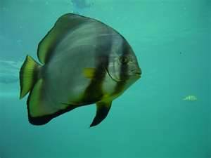
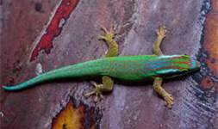
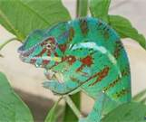
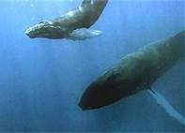
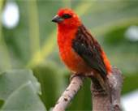
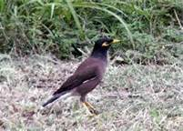
WE HAVE A VERY RICH AND VARIED FAUNA

Slide 10
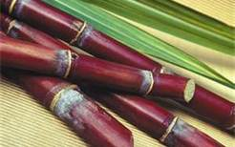
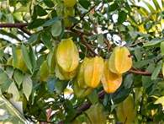
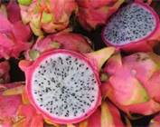
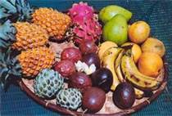
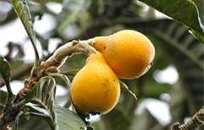
SO IS THE FLORA
Sugar cane
Caramboles
Pitaya
A fruit basket
Bibasses

Slide 11
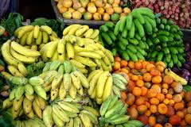
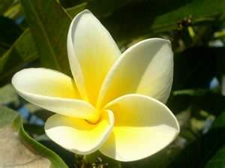
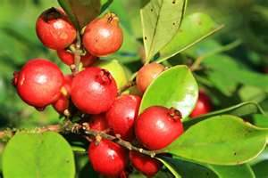
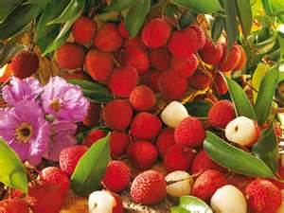
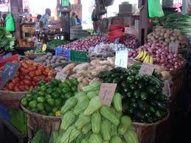
Frangipane
At the market
Goyavier
Litchis

Slide 12
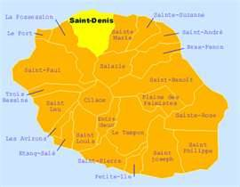
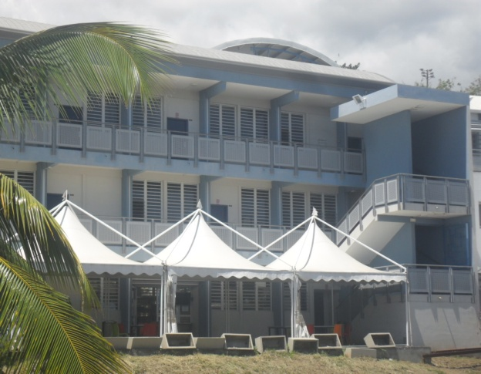
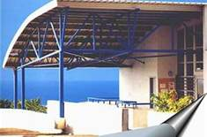
OUR HIGH SCHOOL IS LOCATED IN SAINT-DENIS, IN THE NORTH OF REUNION ISLAND.
L’Horizon Vocational High School
The Languages building

Slide 13
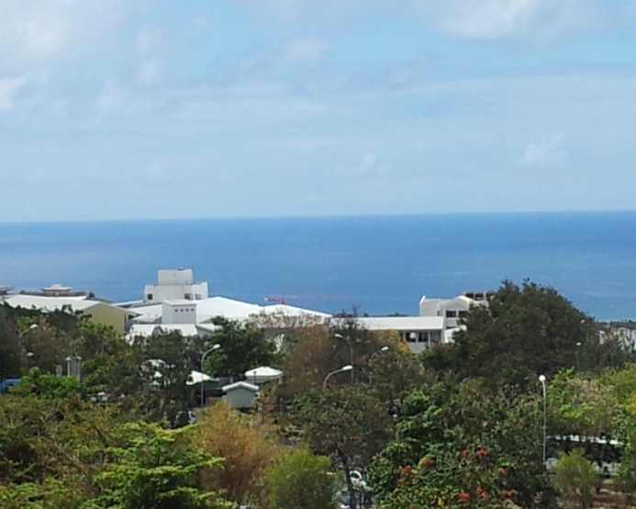
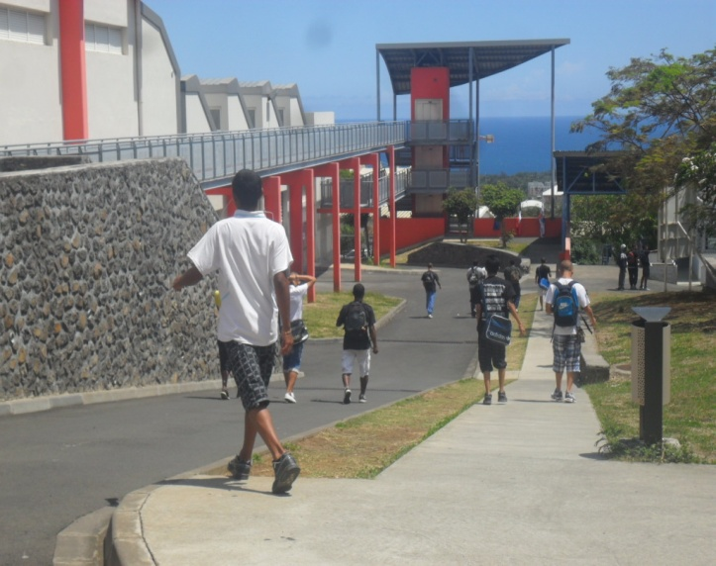
WE CAN SEE THE HORIZON FROM OUR SCHOOL, HENCE ITS NAME…

Slide 14
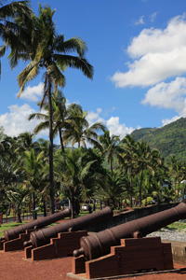
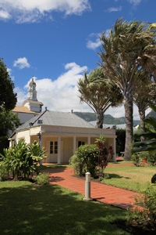
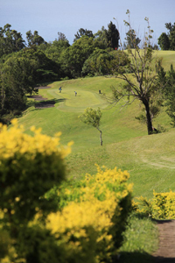
SAINT-DENIS IS THE MAIN CITY OF REUNION ISLAND
Les Canons du Barachois
A typical traditional house
Le Colorado

Slide 15
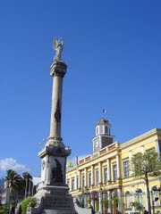
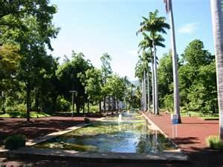
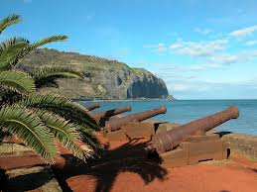
THERE ARE MANY INTERESTING PLACES TO VISIT…
Philippe Mathieu
Le Jardin de l’Etat
Le Barachois
The Town Hall

Slide 16
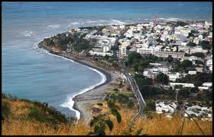
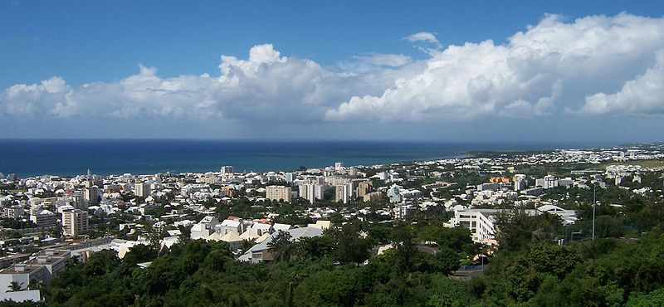
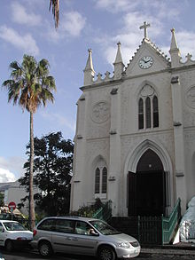
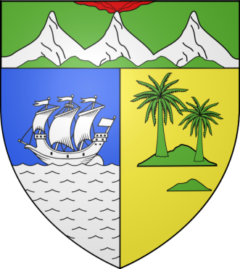
IN SAINT - DENIS THERE ARE ABOUT 145,000 INHABITANTS
The church of St-Jacques

Slide 17
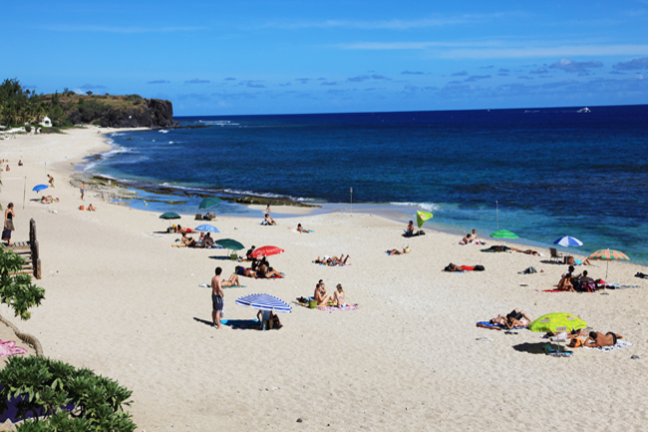
WE HAVE 17 MILES OF WARM WELCOMING BEACHES
IT’S TIME FOR A SUNBATH …

Slide 18
BEACHES, WATERFALLS.
WATER IS EVERYWHERE …

Slide 19
WE HOPE TO SEE YOU HERE SOON…
The End… 
The pupils of 2BGA

Slide 20
THIS POWERPOINT WAS MADE BY
Hyldat
Maïmouna
Nihade
Raïcha
Sifati
Loïck
 
Thank you for watching our presentation …
Mrs Amacouty (Teacher)

