Slide 1
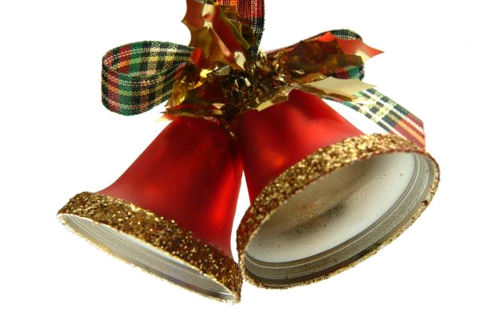
Hrvatske božićne pjesme
Croatian Christmas songs

Slide 2
In next slides we are going to show you some Christmas songs that are sang Croatia.

Slide 3
Zvončići, zvončići
Hej, zvončići, zvončići, zvone cijelu noć,
I ostaju u sjećanju što nikad neće proć.
Hej, zvončići, zvončići, zvone na sav glas,
Kroz tihu noć, čitav kraj, zvone za sve nas. This is the refrain of the song Zvončići( Jingle Bells ) ☺ .

Slide 4
Bijeli Božić
Ja sanjam jedan bijel Božić da opet dođe u moj grad da su zvijezde gore i tiho da se stvore svi ljudi koje volim ja This song was performed by many bands. But best was by Crvena Jabuka( Red Apple ) famous band from Croatia.

Slide 5
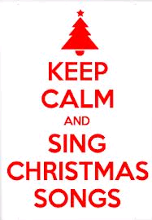
Sretan Božić svakome
Snijeg svud pada Zvona zvone Srca mlada vesele se To je vrijeme ljubavi i mira Sretan Božić svakome This is one of our favourite song and its very amusing!

Slide 6
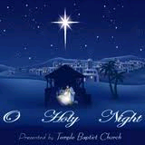
Tiha noć ( Holy Night )
Tiha noć, sveta noć Ponoć je, spava sve Samo Marija s Josipom bdi Divno djetešce pred njima spi Rajski resi ga mir Rajski resi ga mir One of the best known song in Croatia!Its singed in churchs.

Slide 7
Made by: Klara H., Lovro M. & Mateo C. from 7.b

