Slide 1
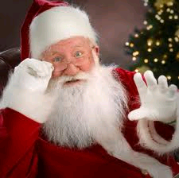
Letter to Santa Claus

Slide 2
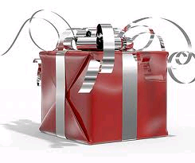
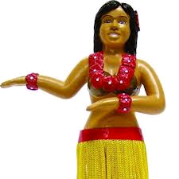
Dear Santa
Dear Santa the Claus,
we were very good boys so we want some gifts due it so here are our wishes:

Slide 3
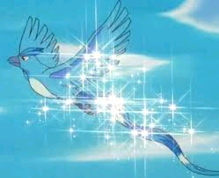
Our wishes:
1. We want peace in the World, without any war because all people deserve to live peacefully.

Slide 4
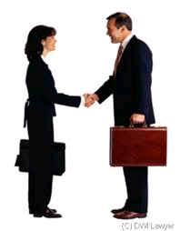
Our wishes:
2. We want to have good jobs when we grow up

Slide 5
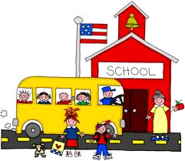
Our wishes:
3. We would like better marks in school so we can get into schools we wish

Slide 6
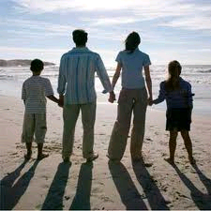
Our wishes:
4. We want to have a nice family when we grow up

Slide 7
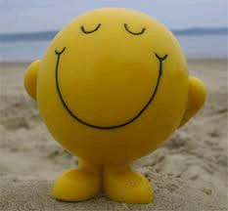
Our wishes:
5. We want to be healty and happy

Slide 8
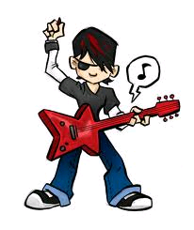
Our wishes:
6. We would like to be famous

Slide 9
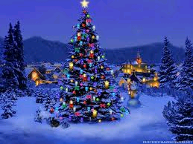
Our wishes:
7. We would like to have nice Christmas trees every year in my house

Slide 10
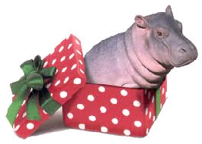
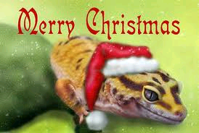
Our wishes:
8. We want that you give us alot of animals because we like animals very very much

Slide 11
Our wishes:
And our last wish is to meet you Santa in person! ☺

Slide 12
Merry Christmas - Sretan Božić
MADE BY: Karlo J. Simon K. Zvonimir M. Dario T.us

