Slide 1
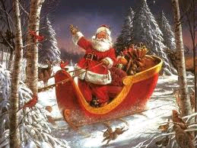
Christmas meals

Slide 2
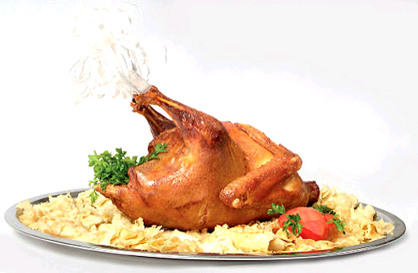
-turkey and grinders

Slide 3
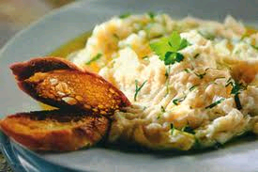
-cod

Slide 4
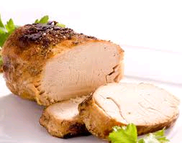
-roast suckling pig

Slide 5
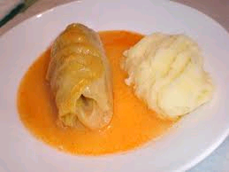
-cabbage rolls

Slide 6
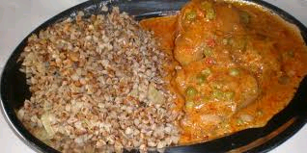
-duck with buckwheat porridge

Slide 7
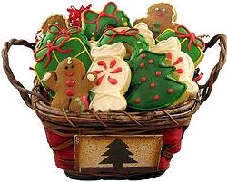
Christmas cookies

Slide 8
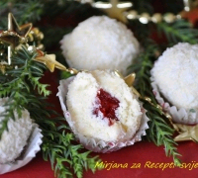
-snow globe of coconut

Slide 9
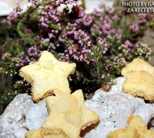
-star with coconuts

Slide 10
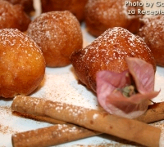
-fritters with apples and yogurt

Slide 11
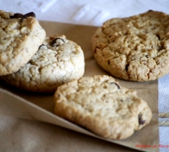
-homemade biscuits from nuts

Slide 12
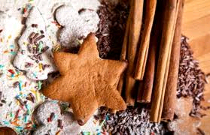
-cookies with cinnamon

Slide 13
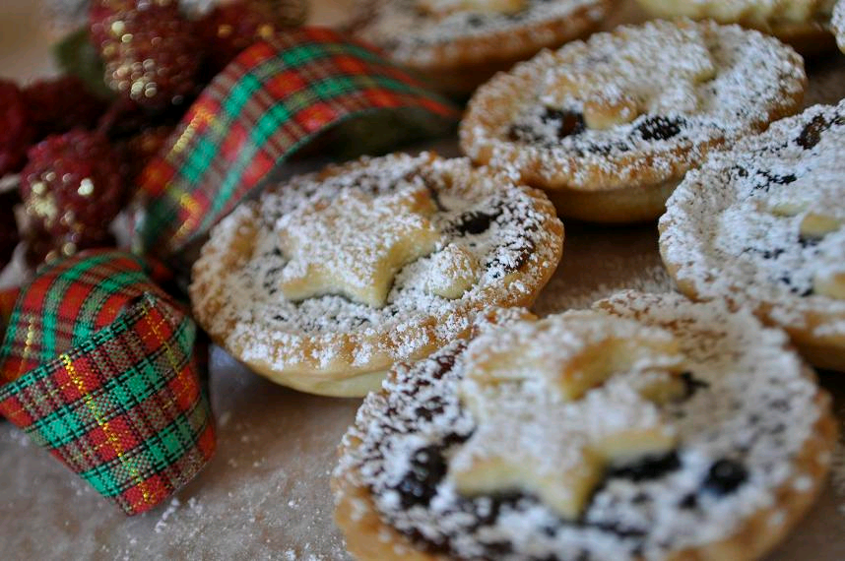
-christmas cake

Slide 14
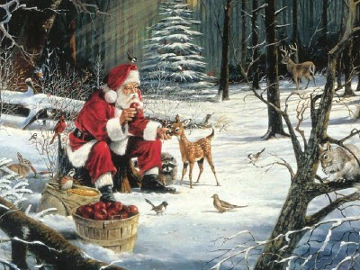
Merry Christmas and Happy New Year!
Sretan Božić i Nova godina!

Slide 15
By: Mia, Mia, Blanka i Asja

