Slide 1
Erasmus+ Ecological literacy
2nd short-term exchange of students
1st Primary School Čakovec, Croatia
23-29/04/2017 http://os-prva-ck.skole.hr/projekti/ecological_literacy

Slide 2
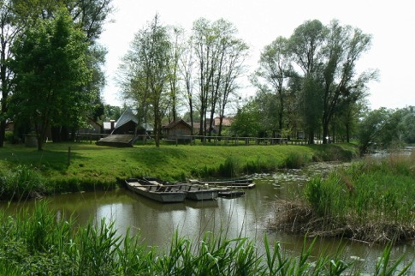
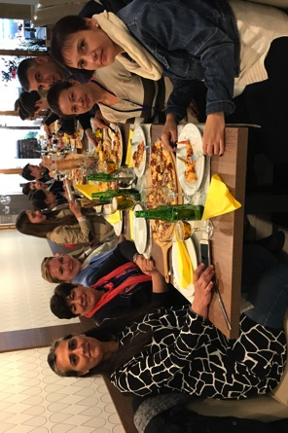
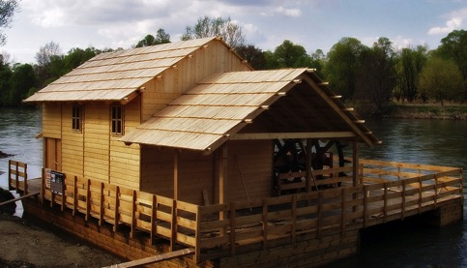
trip to the river Mura;
visit to Sveti Martin na Muri (educational eco trail and mill)

Slide 3
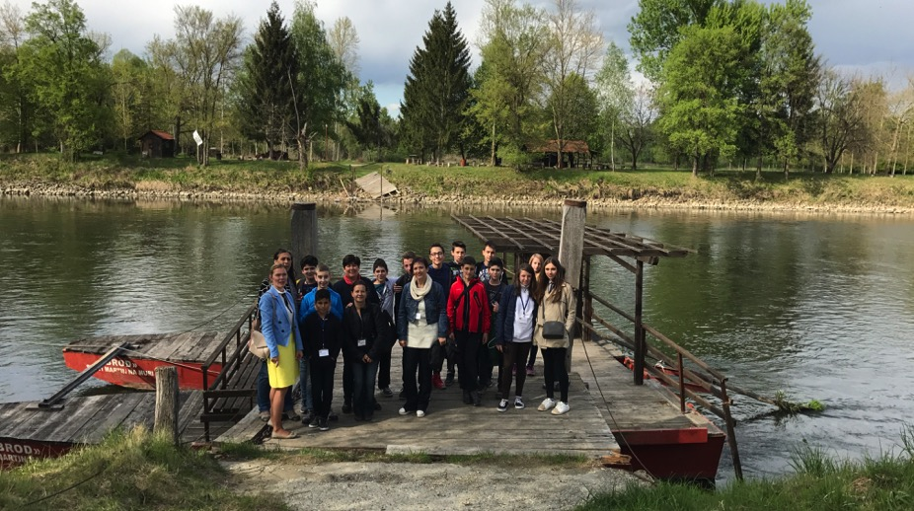
trip to the river Mura; visit to Sveti Martin na Muri (educational eco trail and mill)

Slide 4
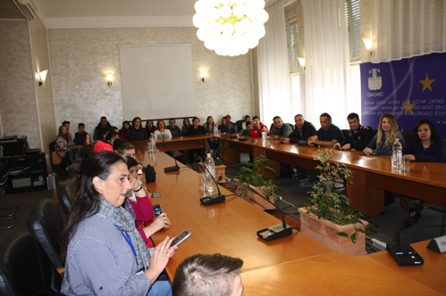
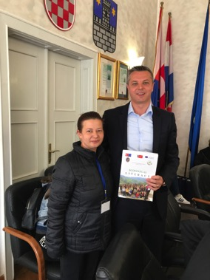
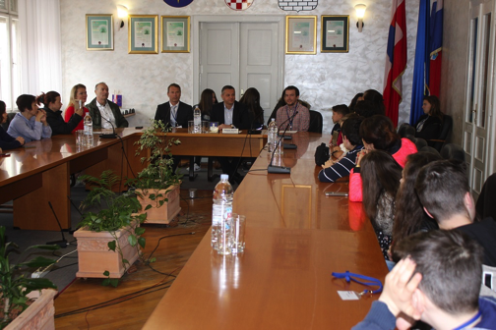
reception with the mayor of the town of Čakovec
Mr. Stjepan Kovač

Slide 5
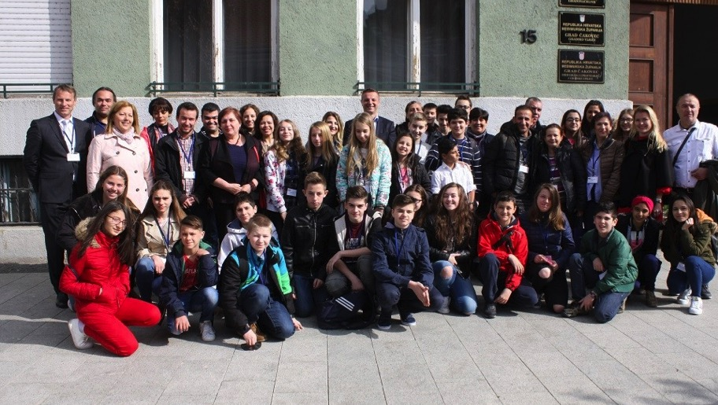
ČAKOVEC: tour of the town center

Slide 6
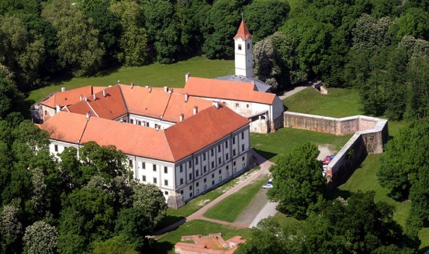
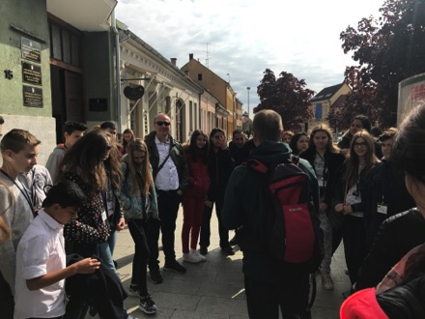
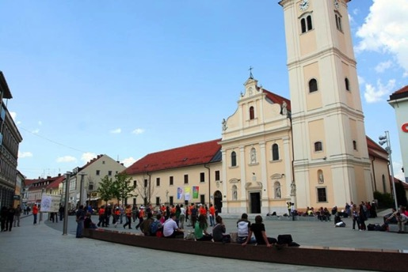
ČAKOVEC: tour of the town center

Slide 7
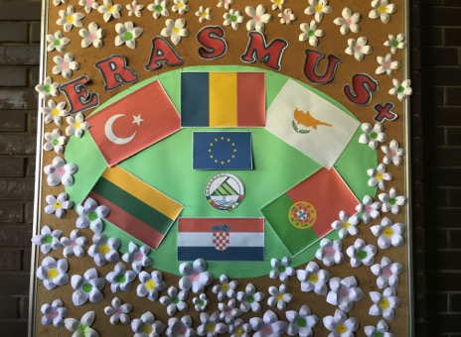
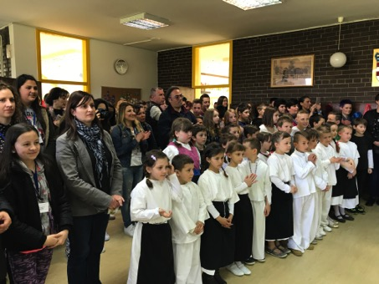
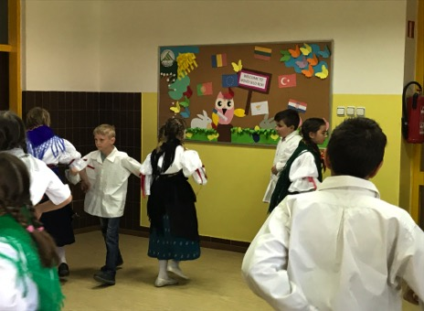
visit to our branch school
PŠ Novo Selo Rok

Slide 8
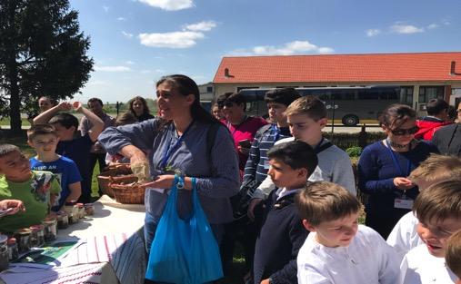
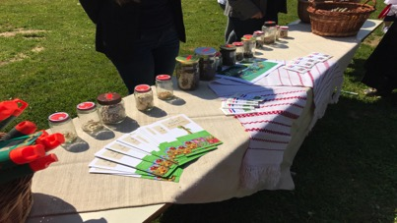
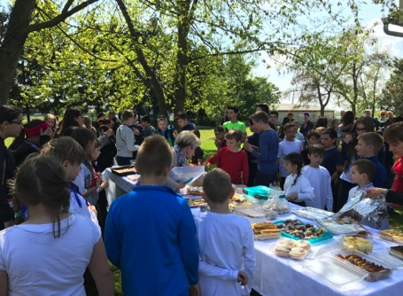
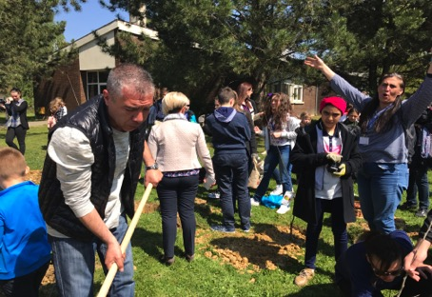
visit to our branch school PŠ Novo Selo Rok

Slide 9
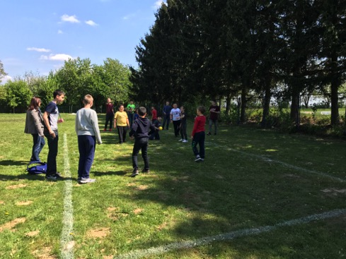
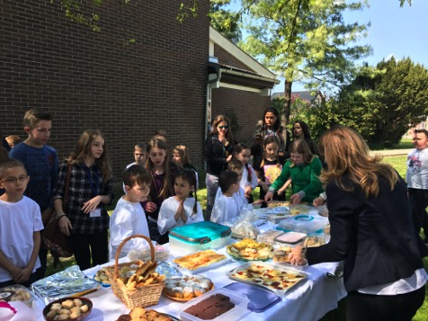
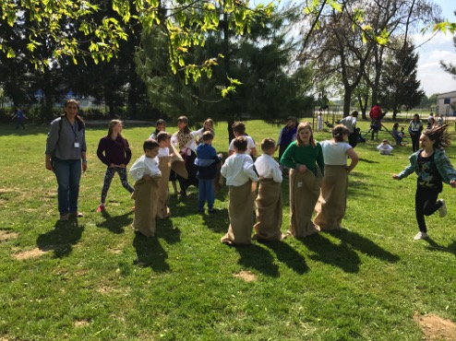
visit to our branch school
PŠ Novo Selo Rok

Slide 10
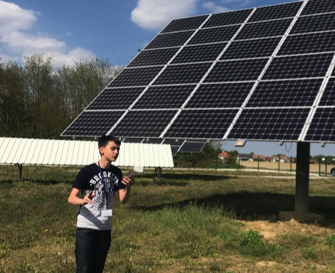
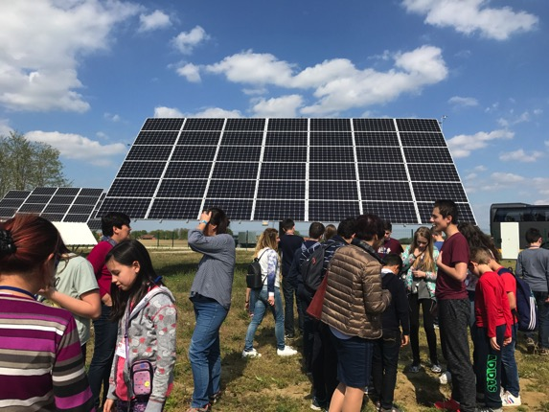
visit to solar collectors

Slide 11
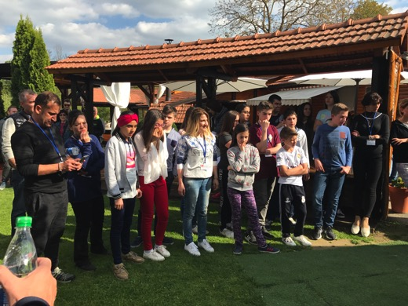
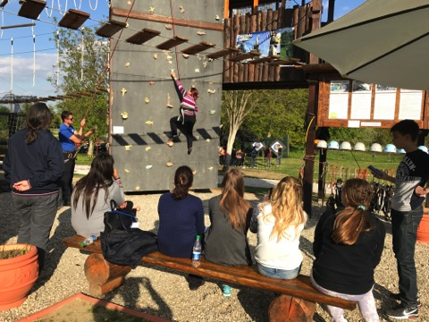
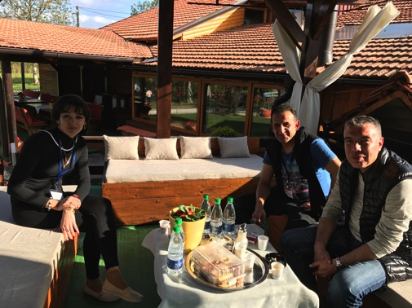
visit to the adventure park Accredo

Slide 12
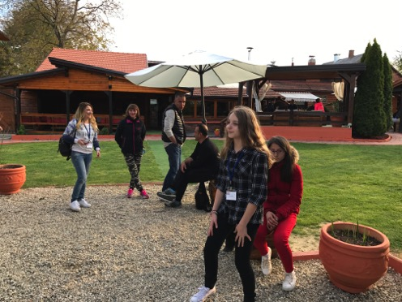
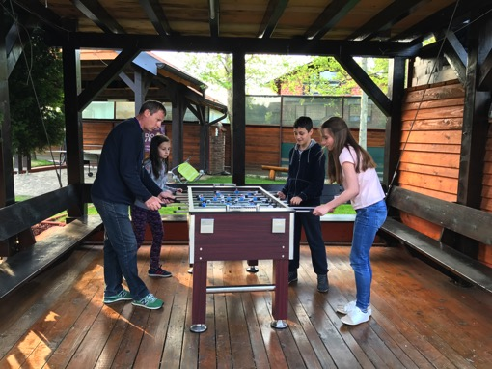
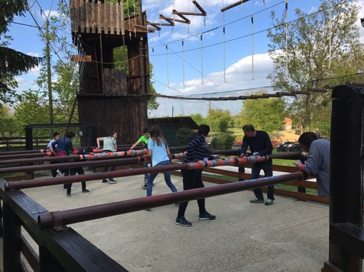
visit to the adventure park Accredo

Slide 13
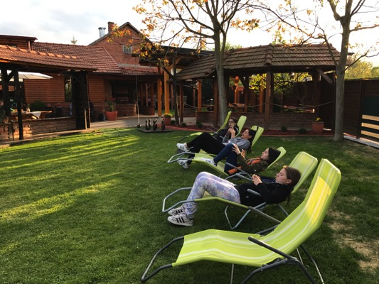
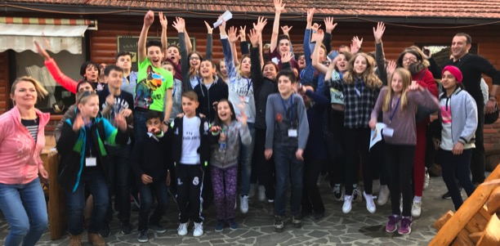
visit to the adventure park Accredo

Slide 14
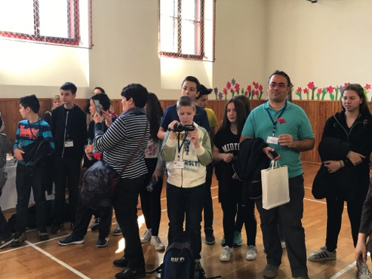
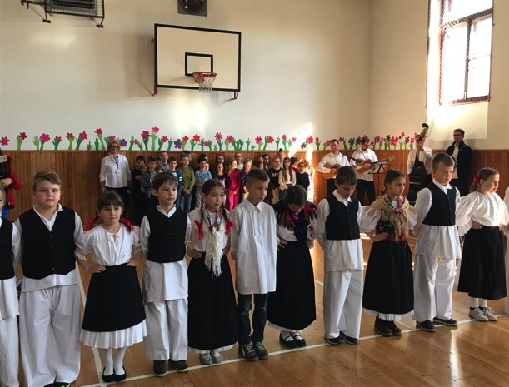
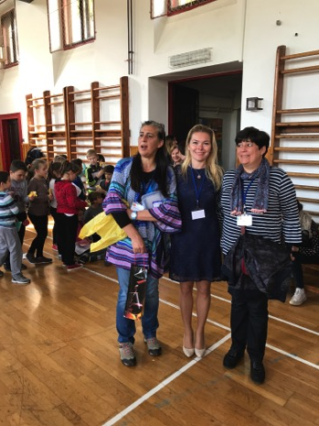
reception at the school

Slide 15
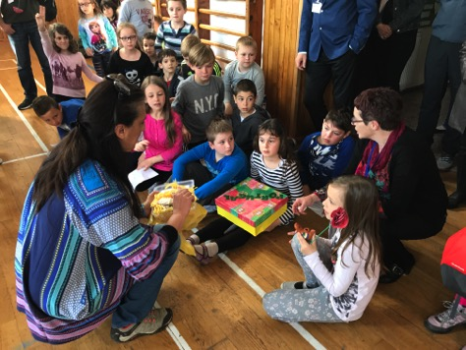
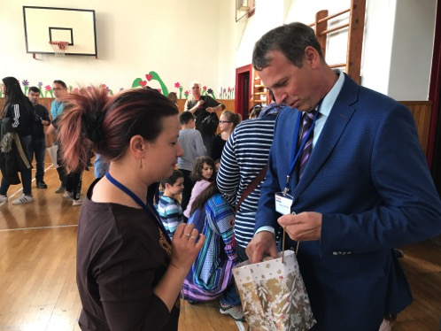
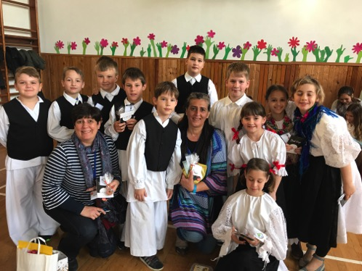
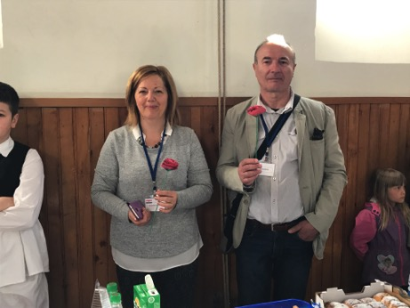

Slide 16
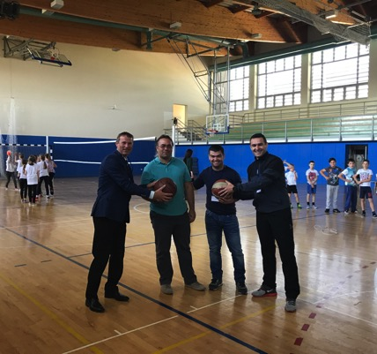
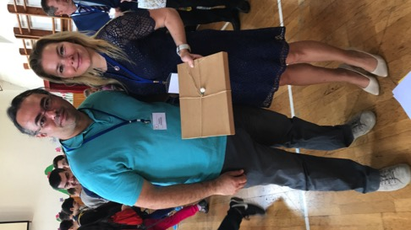
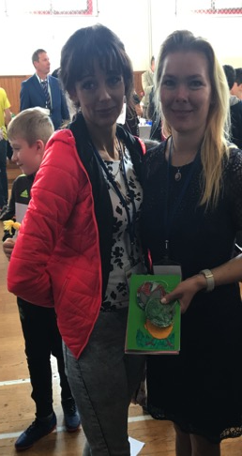
tour of the school

Slide 17
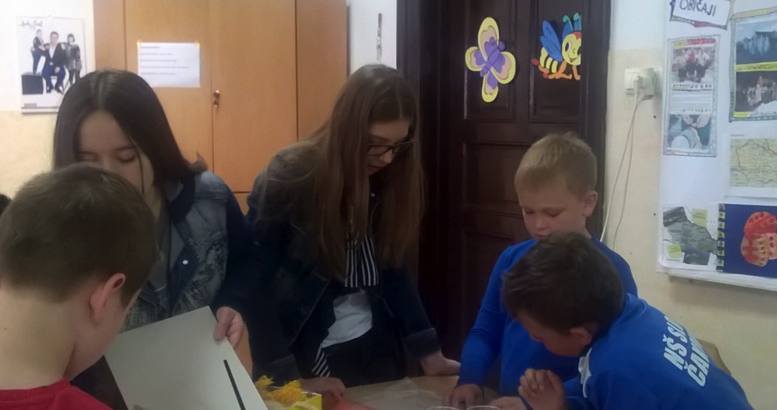
workshops

Slide 18
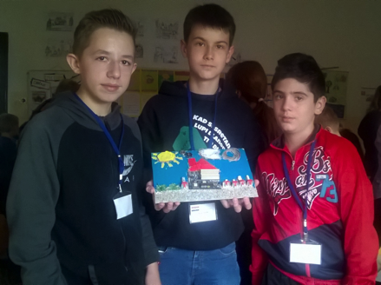
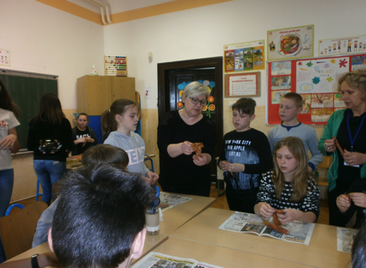
workshops

Slide 19
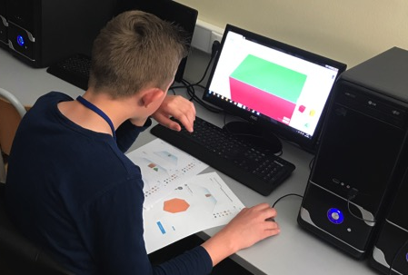
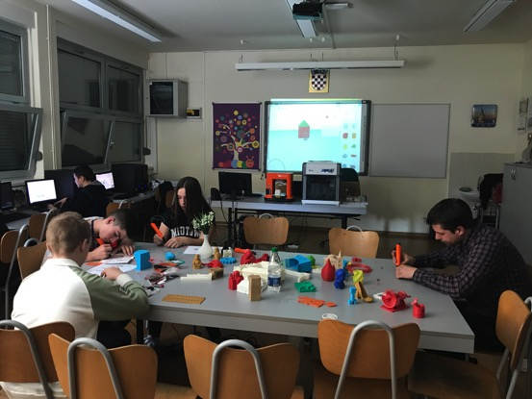
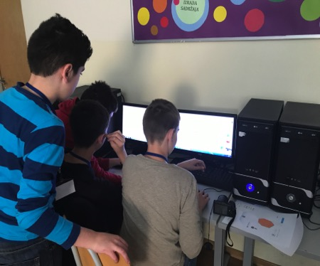
workshops

Slide 20
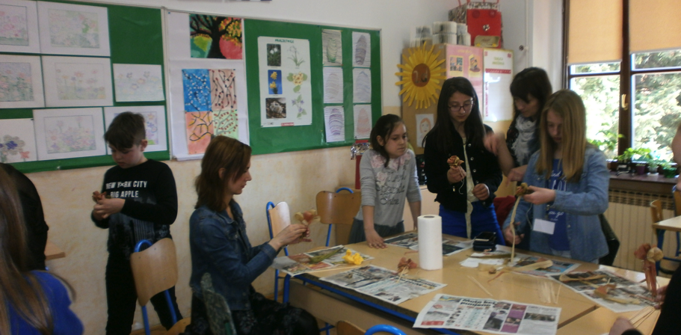
workshops

Slide 21
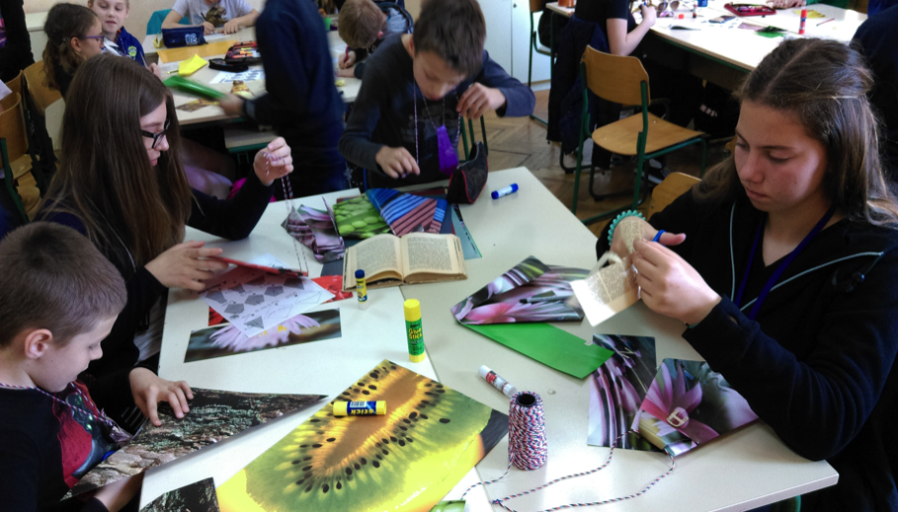
workshops

Slide 22
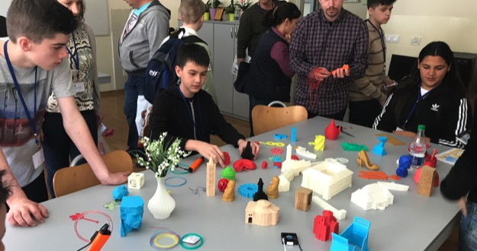

workshops

Slide 23



boating on the river Drava

Slide 24



boating on the river Drava

Slide 25

visit to the Trakošćan castle

Slide 26



visit to the Trakošćan castle

Slide 27

tour of the capital city of Zagreb

Slide 28

tour of the capital city of Zagreb

Slide 29

trip to Varaždin

Slide 30



trip to Varaždin

Slide 31

swimming at the pools

Slide 32


visit to Tehnix

Slide 33


visit to Tehnix

Slide 34



visit to Donji Vidovec

Slide 35

Visit to Donji Vidovec

Slide 36


Visit to Donji Vidovec

Slide 37



Cultural afternoon

Slide 38



Cultural afternoon

Slide 39



awarding certificates

Slide 40



awarding certificates

Slide 41



Party dinner

Slide 42



Visit to the museum

Slide 43




celebration day of the County of Međimurje

Slide 44
Erasmus+ Ecological literacy
2nd short-term exchange of students
1st Primary School Čakovec, Croatia
23-29/04/2017 http://os-prva-ck.skole.hr/projekti/ecological_literacy

