Slide 1
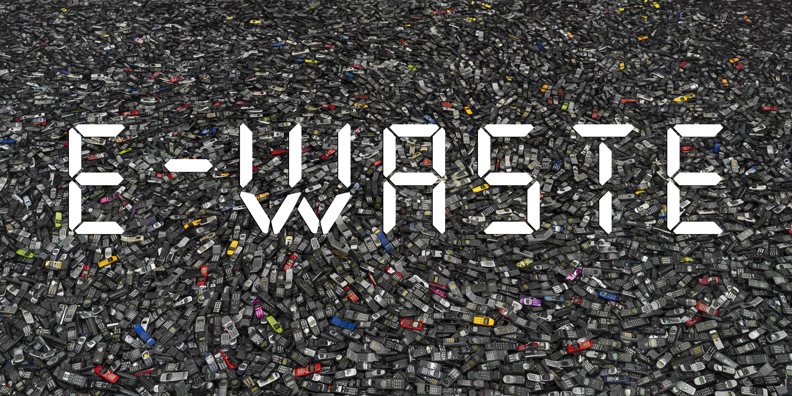
ELECTRONIC WASTE
ANA NOVINŠČAK

Slide 2
CONTENT
What is electronic waste?
Sources of e-waste
How these become e-waste?
How to recognize e-waste?
How to recycle e-waste?
Why is electronics recycling important?
How can consumers recycle their e-waste?
Are you alowed to throw e-waste into the trash?
How much e-waste is there per year?
Effects of e-waste on enviroment
The states by recycling waste

Slide 3
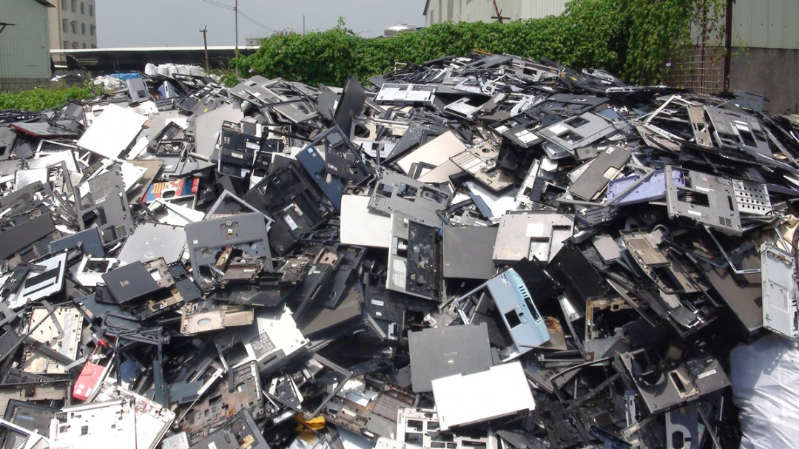
WHAT IS ELECTRONIC WASTE?
Electronic waste or e-waste describes discarded electrical or electronic devices
Used electronics which are destined for reuse, resale, salvage, recycling, or disposal are also considered e-waste

Slide 4
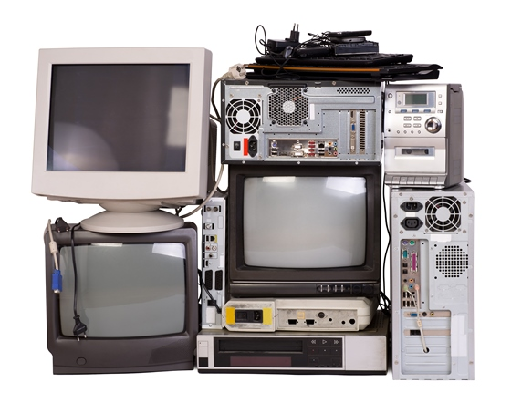
SOURCES OF E-WASTE
HOME
HOSPITALS
GOVERNMENT
PRIVATE SECTORS

Slide 5
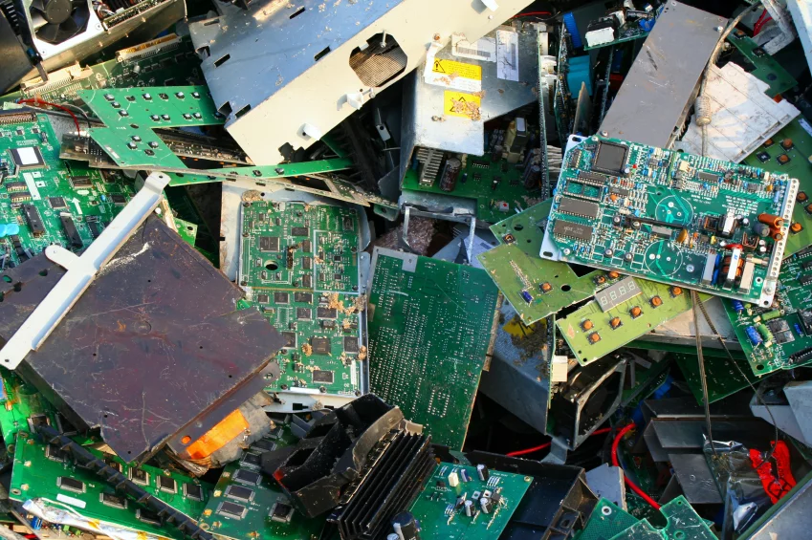
HOW THESE BECOME E-WASTE?
Advancement in technology
Changes in stile, fashion and status
Nearing the end of their useful life
Not taking precautions by handling them

Slide 6
HOW TO RECOGNIZE E-WASTE?
Every device which needs to be disposed separately from other waste is E-waste and has this label:

Slide 7
HOW TO RECYCLE E-WASTE?
Find a responsible recycler
Donate for reuse if possible
Give them to manufacturers

Slide 8
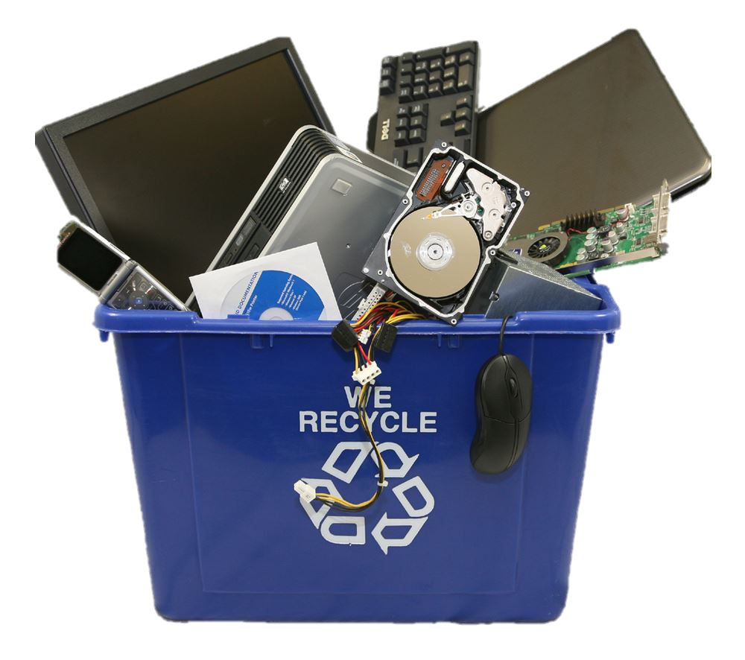
WHY IS ELECTRONICS RECYCLING IMPORTANT?
old electronic devices contain toxic substances such as lead, mercury, cadmium and chromium, proper processing is essential to ensure that these materials are not released into the environment
If is not separated properly there will be excessive waste generation

Slide 9
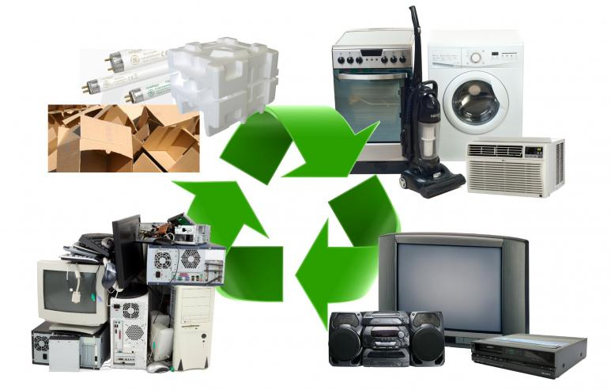
HOW CAN CONSUMERS RECYCLE THEIR E-WASTE?
The best choice is to donate computer equipment that can be refurbished or reused as is
On electronics recycling events
On authorized electronics recycler locations

Slide 10
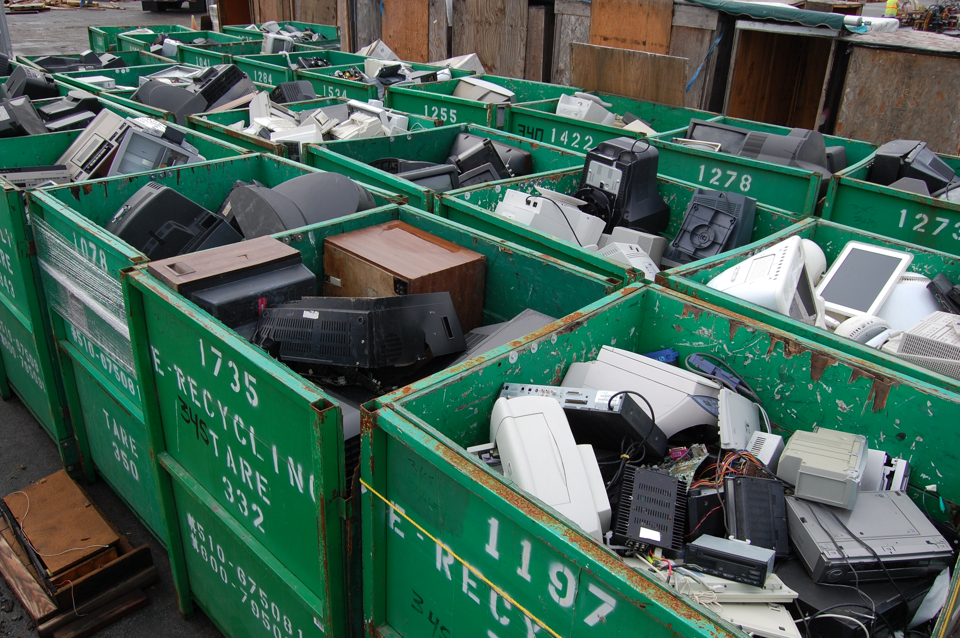
ARE YOU ALLOWED TO THROW E-WASTE INTO THE TRASH?
That depends on device and your location, but please rather…
RECYLE

Slide 11
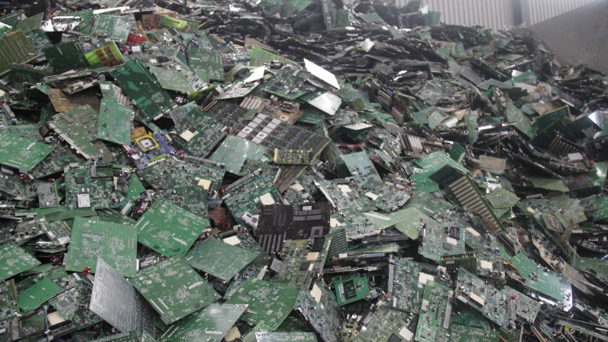
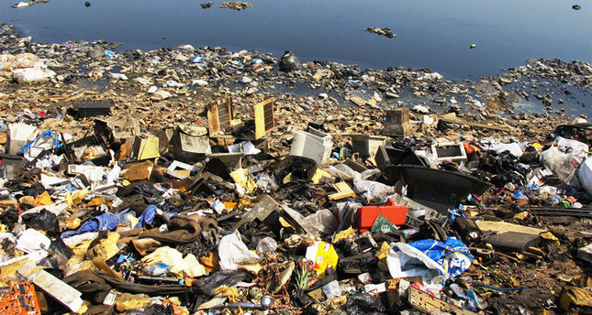
HOW MUCH E-WASTE IS THERE PER YEAR?
20 to 50 million metric tons of e-waste are disposed worldwide every year

Slide 13
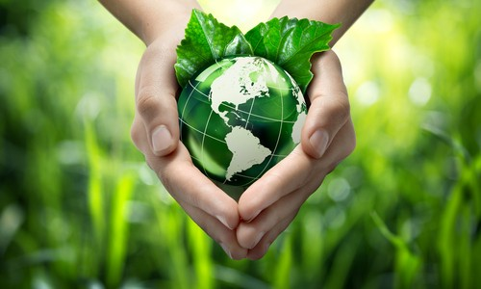
THE STATES BY RECYCLING WASTE
TOP 10
GERMANY
SOUTH KOREA
SLOVENIA
AUSTRIA
BELGIUM
SWITZERLAND
SWEDEN
NETHERLANDS
LUXEMBOURG
ICELAND

Slide 14
DON’T FORGET TO RECYCLE SO THAT WE CAN LIVE IN WORLD WITHOUT WASTE AND GARBAGE- IN A CLEAN, HAPPY WORLD!

Slide 15
THANK YOU FOR YOUR ATTENTION!
ANA NOVINŠČAK

