Slide 1
Electronic waste

Slide 2
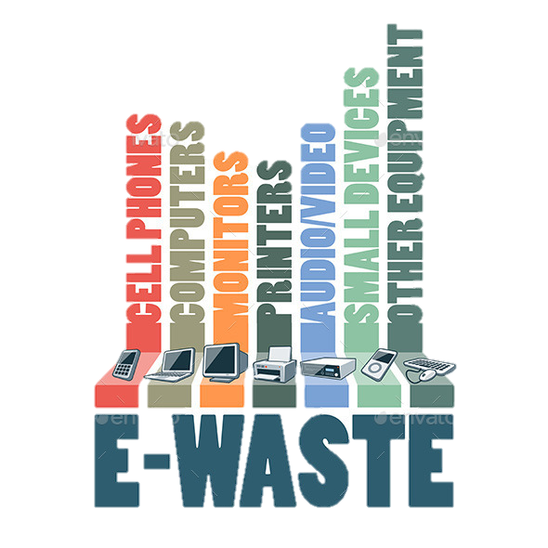
What is electronic waste?
Electronic waste or e-waste is describes discarded electrical or electronic devices.
Used electronics which are destined for reuse, resale, salvage, recycling, or disposal are also considered e-waste.

Slide 3
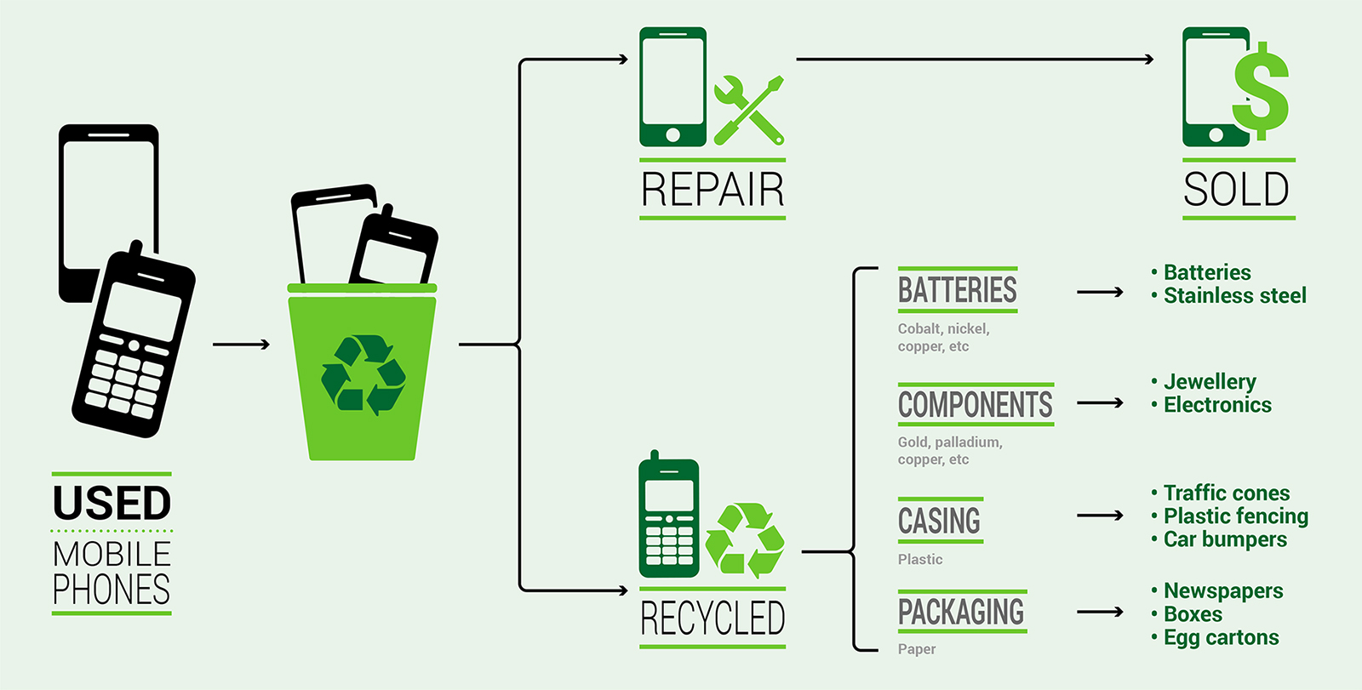
What do we do have to do with electronic waste?
Best way is to Recycle!
The circuit boards contain such precious metals as gold, silver, platinum, etc. and such base metals as copper, iron, aluminum, etc.
We may require or regain some „lost” materials to help us with something new..

Slide 4
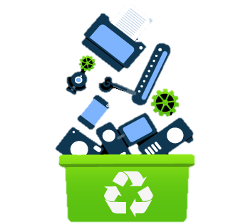
Which countries have the most e-waste in world?
Top ten are:
SAD
China
Japan
Germany
India
UK
France
Brazil
Russia
Italy

Slide 6
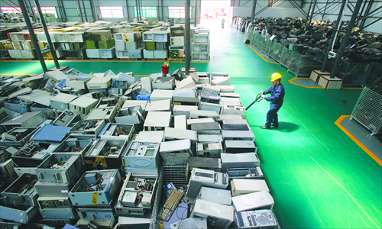
How much waste does sad actually make?
The United States generated far and away the greatest volume of e-waste in 2016. America was responsible for 7.795 million tons of e-waste last year. To put that into perspective, it's more e-waste than when we count together at least 5 more contries’ waste
FUN FACT!

Slide 7
How do you recognise e-waste?
Every e-waste is dangeorous and hast to be disposed properly
You can search fot the label on things to know if they’re e-waste or not!
Labels:

Slide 8
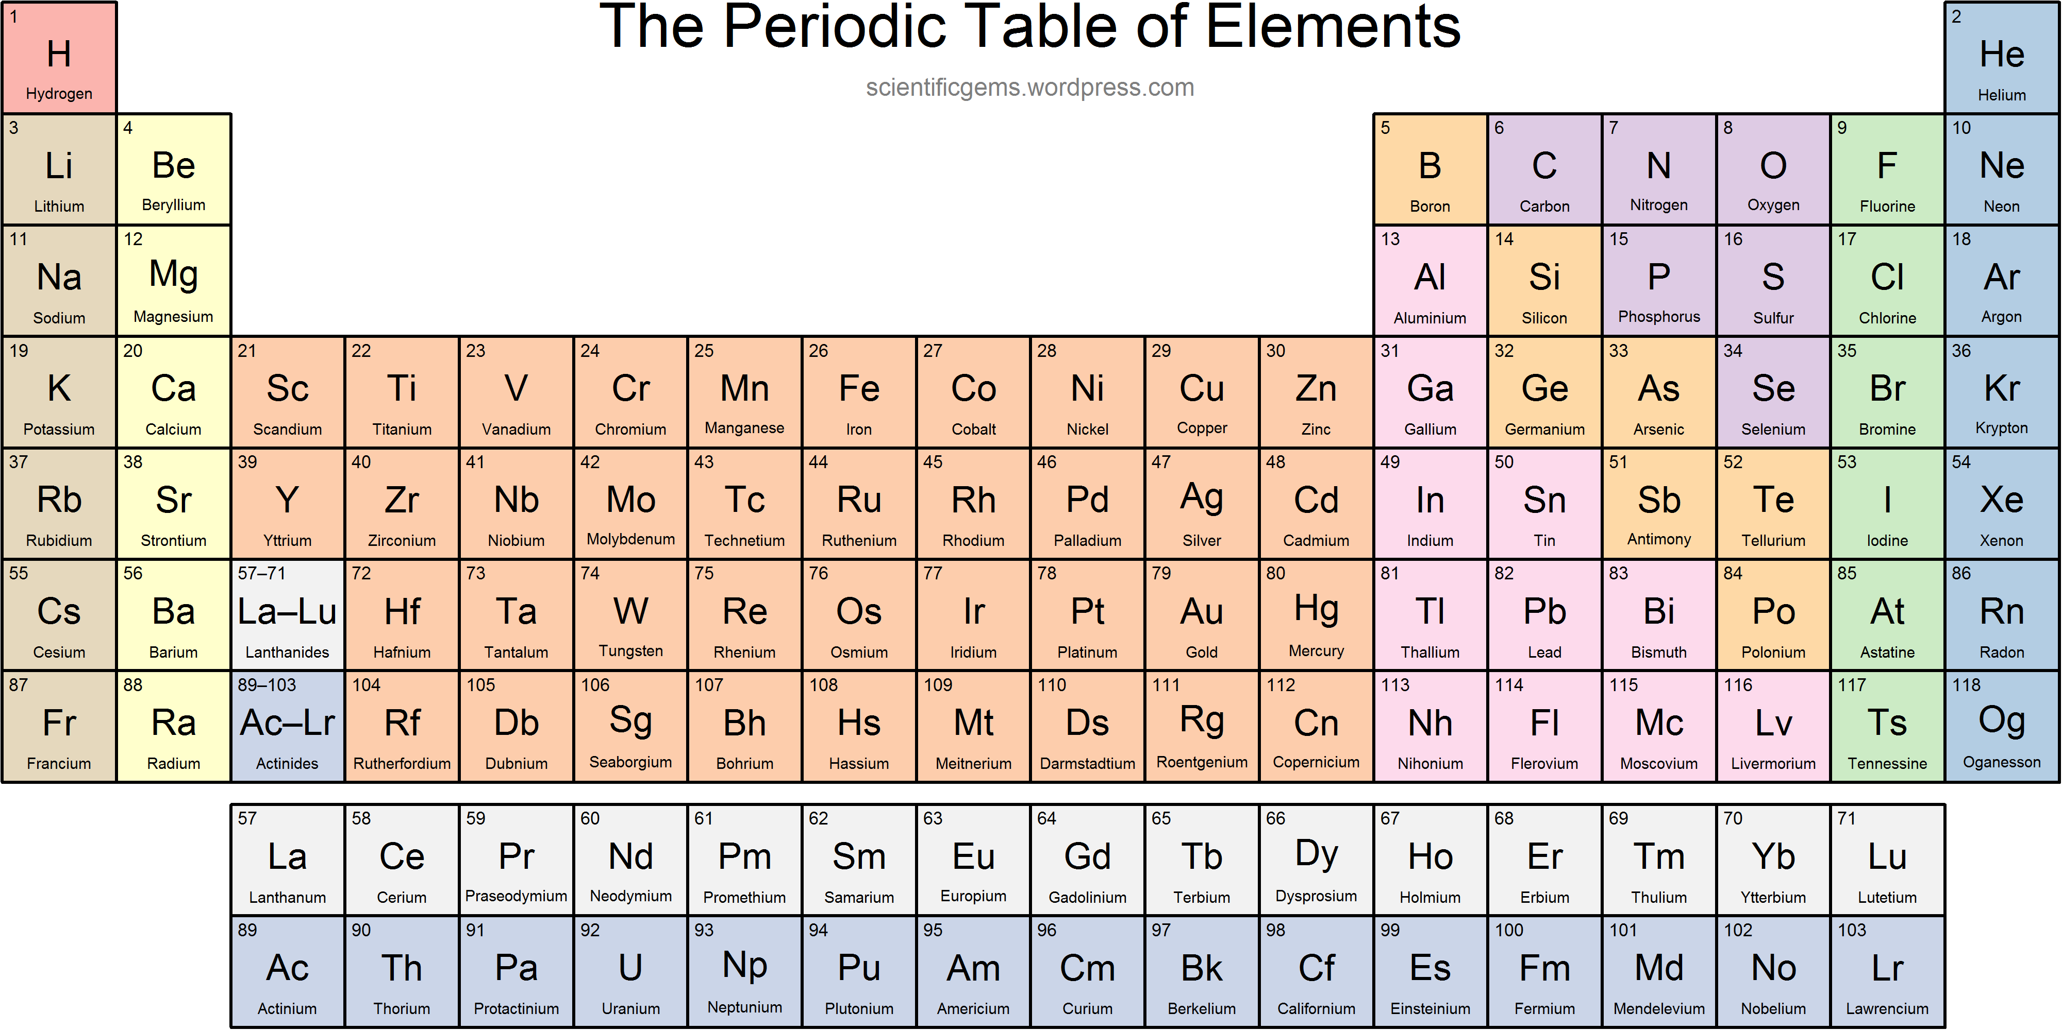
Why is it important to recycle?
Electronic waste can have many toxic elements inside them, even up to 60 elements from the periodic table can be found inside e-waste items, as well as flame retardants and other toxic chemicals!

Slide 9
Other harmful elements include:
Lead, which is in most electronic equipment
Beryllium, a lightweight metal in many electronics
Mercury, in many lighting displays
Polyvinyl chloride, often used for cabling in circuit boards

Slide 11
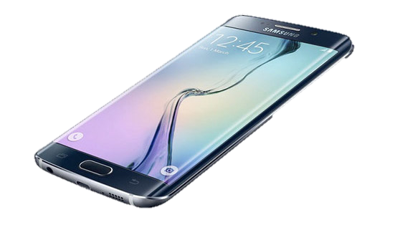
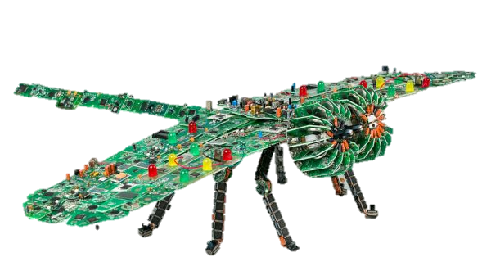
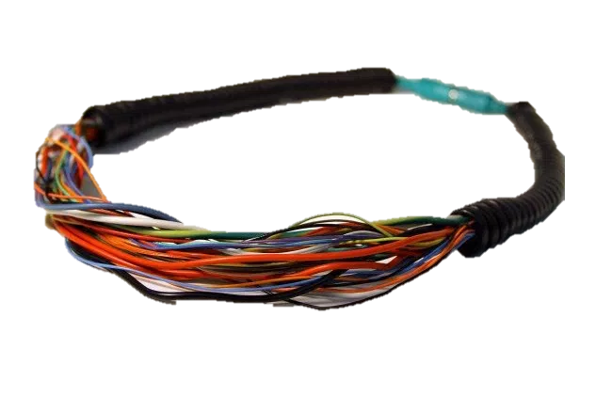
What it can be turned into
The metal from these devices can be used for many things, if extracted properly.
Cell phone batteries and metals inside the phone can be used to make new ones, or for jewelry, art, metal plates, or other electronics.

Slide 12
Company with a good idea!
A company in India, Attero, extracts metals like gold, platinum, and selenium safely from used devices, refurbishes others, and helps businesses with end-to-end electronic asset management. It's a small dent in the grand scheme, but companies like this are important — and profitable.

Slide 13
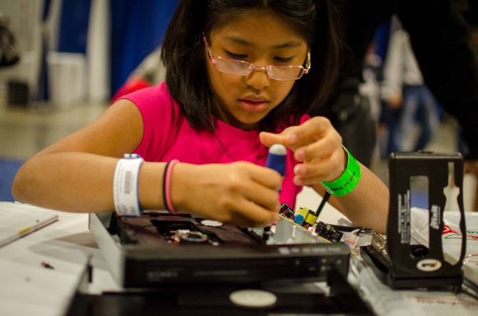
What can we do?
Learn to fix broken gadgets yourself.
Don’t throw them in trash
Dispose properly
Pass them on for reuse
Find a good e-waste recycler
Staples stores

Slide 14
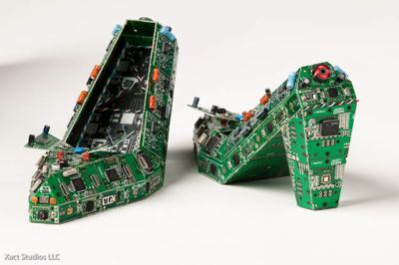
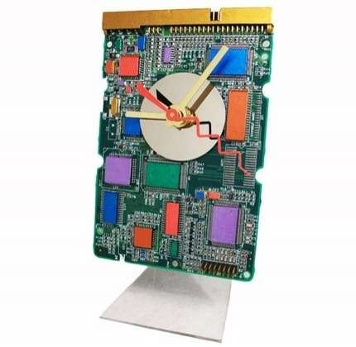
Beware!
A large number of what is labeled as "e-waste" is actually not waste at all, but rather whole electronic equipment or parts that are readily marketable for reuse or can be recycled for materials recovery.

Slide 15
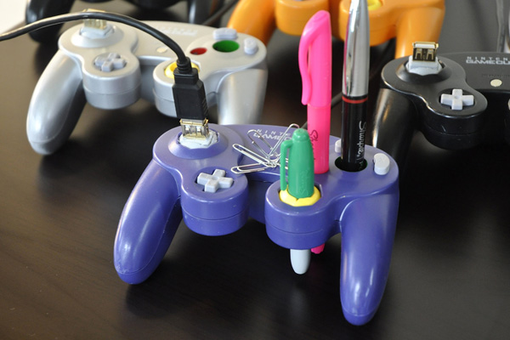
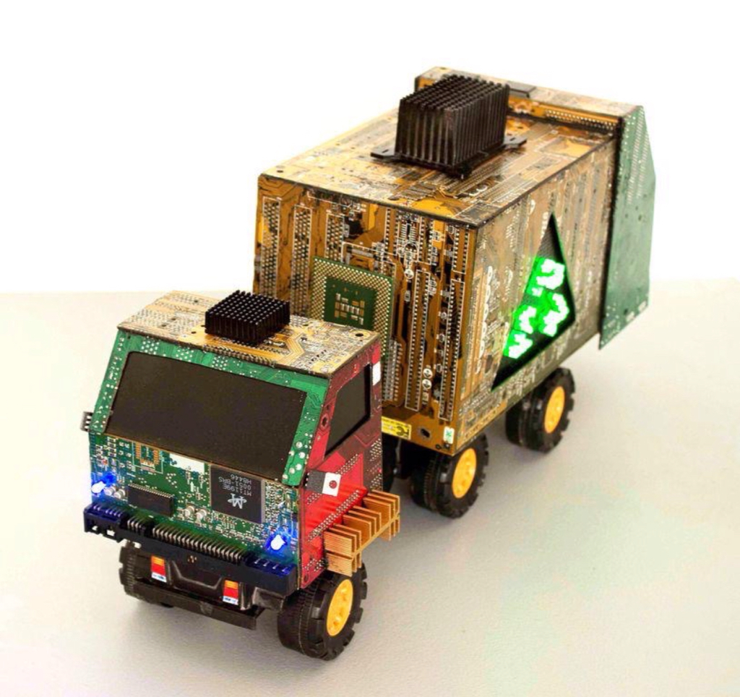
Make fun projects
You can recycle e-waste by yourself!
Do fun projects wth your kids, family, friends and help the environment!

Slide 17
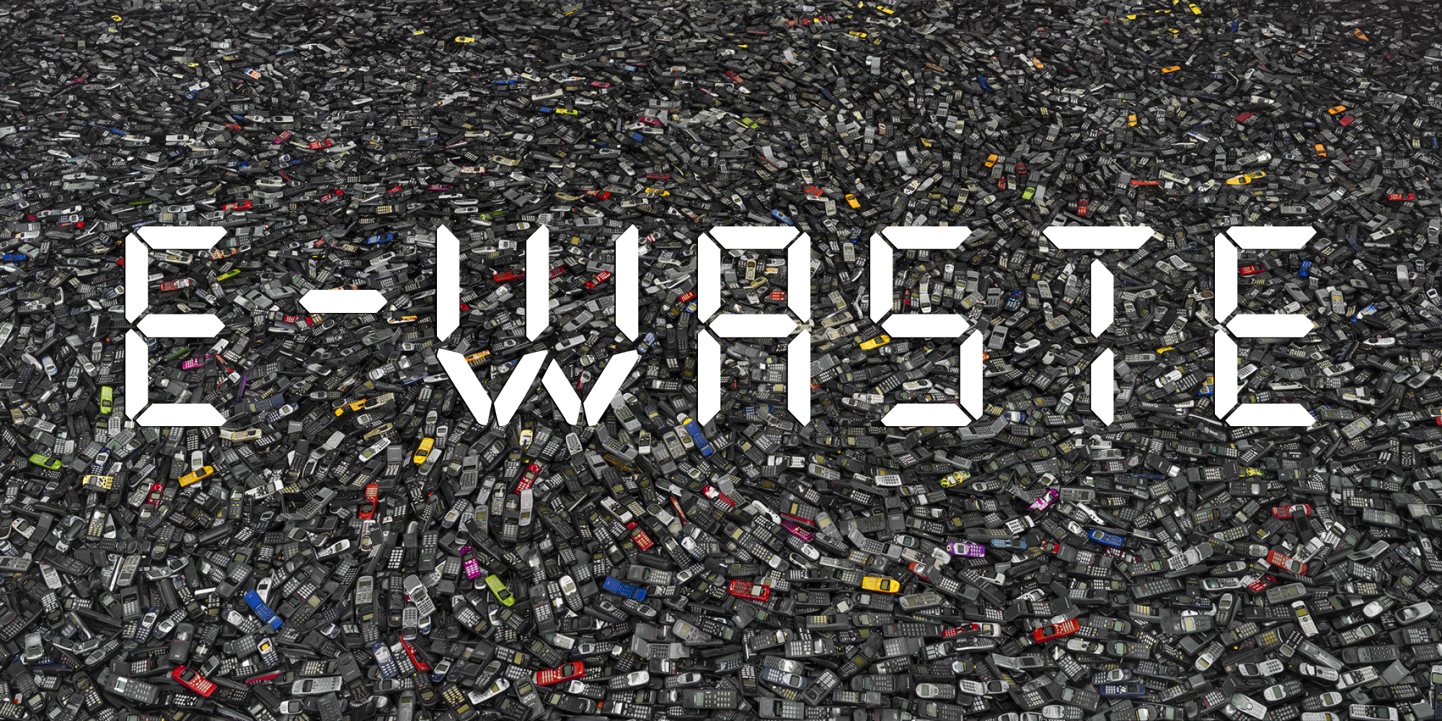
Keep up with the good work!
Never give up trying and you’ll succeed!
Help out the enviroment and people around you, make a good thing by doing something fun!

Slide 18
Thank you for your attention!..

