Slide 1
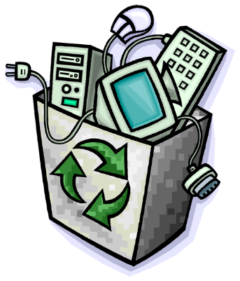
Electronic waste
Sven grozdek
8.c
i.Osnovna škola čakovec

Slide 2
Content
What is electronic waste?
Recycling
Process of recycling

Slide 3
What is electronic waste?
Outdated computer equipment, stereos, televisions ,mobile phones, etc.

Slide 5
Recycling
Audiovisual components, televisions, VCRs, stereo equipment, mobile phones, other handheld devices, and computer components contain valuable elements and substances suitable for reclamation, including lead, copper, and gold.

Slide 7
Why Is Electronics Recycling Important?
Rich Source of Raw Materials
Solid Waste Management
Toxic Materials
International Movement of Hazardous Waste

Slide 9
Process of recycling
Picking Shed
Disassembly
First size reduction process
Second size reduction process
Over-band Magnet
Non-metallic and metallic components separation
Water Separation

Slide 10
Uses of recycling:
Plastic
Glass
Metal

Slide 12
Where can you bring the e-waste?
You can bring it to your local scrap jard or a Comupter Store

Slide 13
Also many stores nowadays are willing to take your E-waste

Slide 15
Are you allowed to throw e waste in the trash?
Whether or not you are allowed to throw EOL electronic devices into the trash.

Slide 17
Someone is maybe willing to take your E-Waste

Slide 18
Environmental impact
The processes of dismantling and disposing of electronic waste in developing countries led to a number of environmental impacts

Slide 20
Thank you for your atteniton

