Slide 1
WAYS TO SAVE ENERGY
1. ELEMENTARY SCHOOL ČAKOVEC

Slide 2
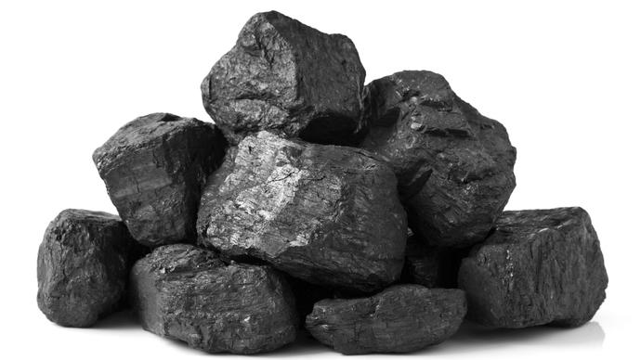
ENERGY
Renewable energy Unrenewable energy
-sunlight, wind, water, -coal, oil, natural gas,
geothermal nuclear
POOF!!!

Slide 3
Energy Saving Tip #1
Replace your incandescent light bulbs

Slide 4
Energy Saving Tip #2
Switch the TV and computer off when not in use

Slide 5
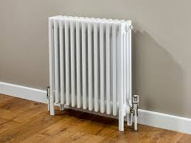
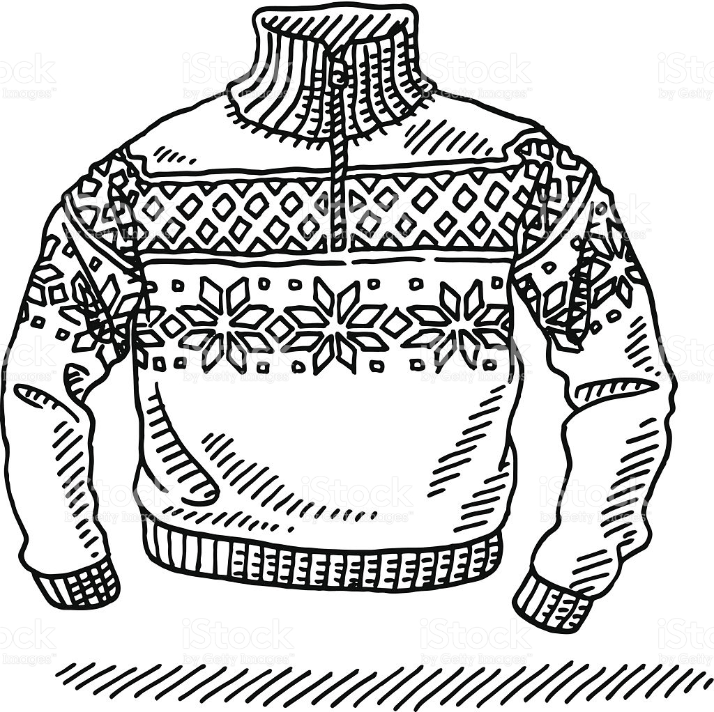
Energy Saving Tip #3
Turn the heating down and dress warm pullover

Slide 6
Energy Saving Tip #4
Turn the lights off if you are not using a room

Slide 7
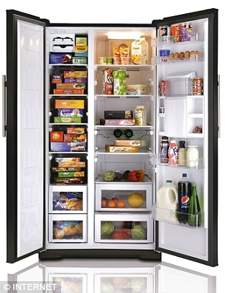
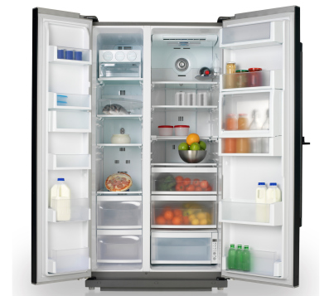
Energy Saving Tip #5
Keep your freezer full

Slide 8
Energy Saving Tip #6
On the sunny day open a curtains and use natural light

Slide 9
Energy Saving Tip #7
Use the shower instead of the bathtub and save the water

Slide 10
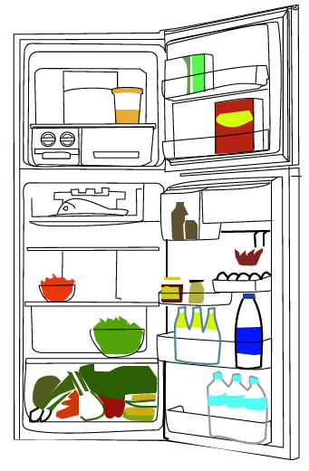
Energy Saving Tip #8
Never put a hot food in a fridge

Slide 11
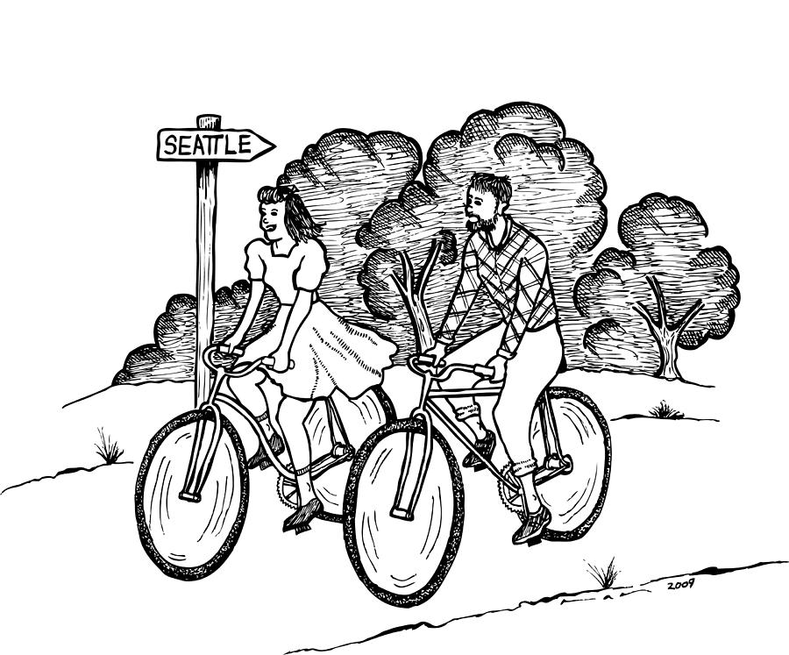
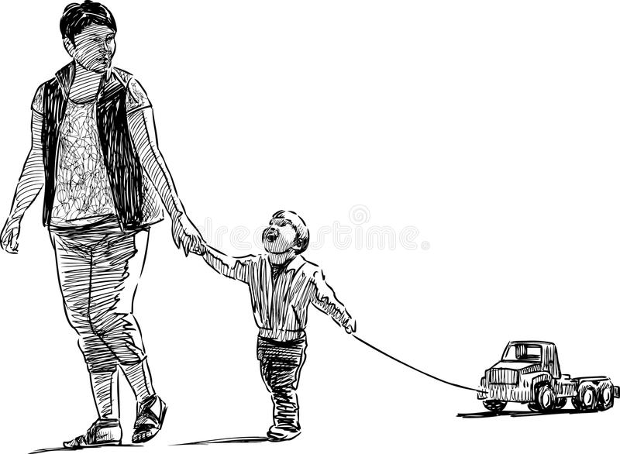
Energy Saving Tip #9
Walk or ride a bike instead driving

Slide 12
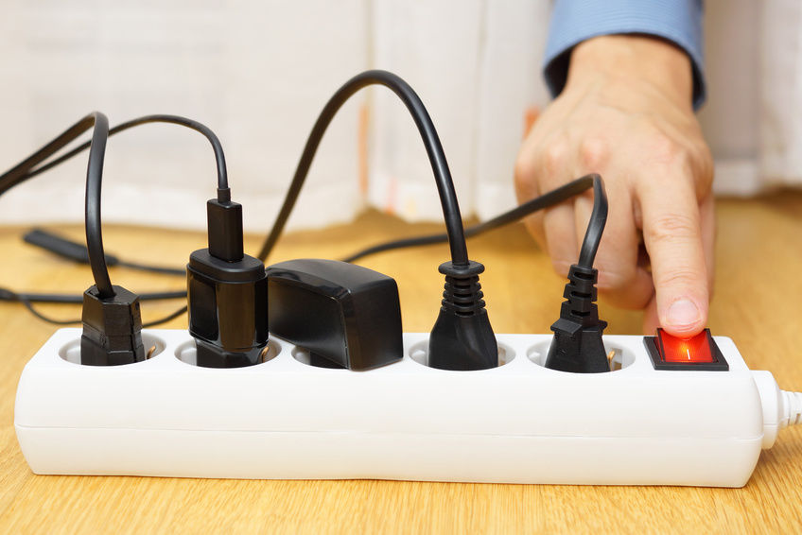
Energy Saving Tip #10
Use power strips

Slide 13
Pay attention when you go shopping:
Buy products with:

Slide 14
Thank you for attention!!!

